Slide 1
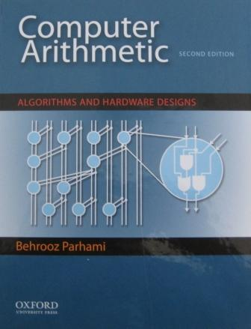
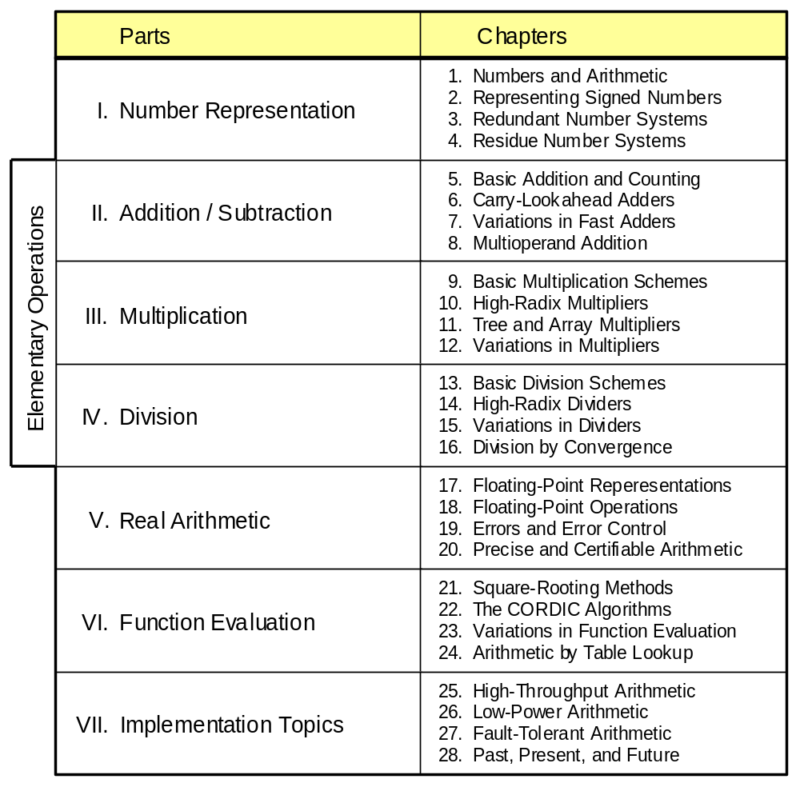
Part III
Multiplication
28. Reconfigurable Arithmetic
Appendix: Past, Present, and Future
Apr. 2020
Computer Arithmetic, Multiplication
Slide <number>

Slide 2
About This Presentation
This presentation is intended to support the use of the textbook Computer Arithmetic: Algorithms and Hardware Designs (Oxford U. Press, 2nd ed., 2010, ISBN 978-0-19-532848-6). It is updated regularly by the author as part of his teaching of the graduate course ECE 252B, Computer Arithmetic, at the University of California, Santa Barbara. Instructors can use these slides freely in classroom teaching and for other educational purposes. Unauthorized uses are strictly prohibited. © Behrooz Parhami
Edition | Released | Revised | Revised | Revised | Revised
First | Jan. 2000 | Sep. 2001 | Sep. 2003 | Oct. 2005 | May 2007
 |  | Apr. 2008 | Apr. 2009
Second | Apr. 2010 | Apr. 2011 | Apr. 2012 | Apr. 2015 | Apr. 2020
Apr. 2020
Computer Arithmetic, Multiplication
Slide <number>

Slide 3
III Multiplication
Review multiplication schemes and various speedup methods
  Multiplication is heavily used (in arith & array indexing)
  Division = reciprocation + multiplication
  Multiplication speedup: high-radix, tree, recursive
  Bit-serial, modular, and array multipliers
Topics in This Part
Chapter 9 Basic Multiplication Schemes
Chapter 10 High-Radix Multipliers
Chapter 11 Tree and Array Multipliers
Chapter 12 Variations in Multipliers
Apr. 2020
Computer Arithmetic, Multiplication
Slide <number>

Slide 4
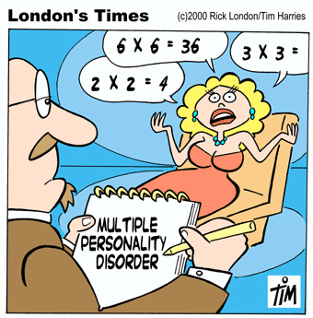
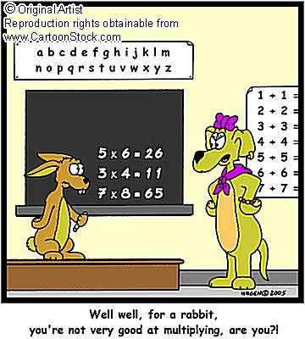
“Well, well, for a rabbit, you’re not very good at multiplying, are you?”
Apr. 2020
Computer Arithmetic, Multiplication
Slide <number>

Slide 5
9 Basic Multiplication Schemes
Chapter Goals
Study shift/add or bit-at-a-time multipliers
and set the stage for faster methods and
variations to be covered in Chapters 10-12
Chapter Highlights
Multiplication = multioperand addition
Hardware, firmware, software algorithms
Multiplying 2’s-complement numbers
The special case of one constant operand
Apr. 2020
Computer Arithmetic, Multiplication
Slide <number>

Slide 6
Basic Multiplication Schemes: Topics
Topics in This Chapter
9.1 Shift/Add Multiplication Algorithms
9.2 Programmed Multiplication
9.3 Basic Hardware Multipliers
9.4 Multiplication of Signed Numbers
9.5 Multiplication by Constants
9.6 Preview of Fast Multipliers
Apr. 2020
Computer Arithmetic, Multiplication
Slide <number>

Slide 7
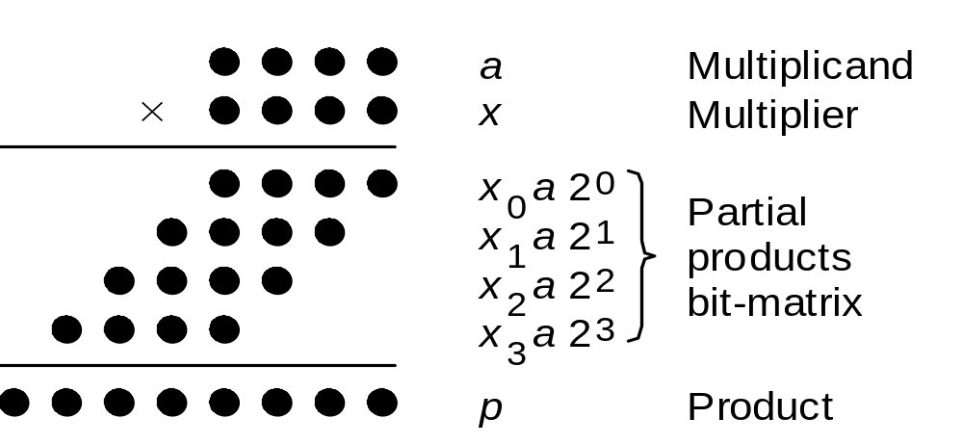
9.1 Shift/Add Multiplication Algorithms
Notation for our discussion of multiplication algorithms:
a Multiplicand a_{k–1}a_{k–2} . . . a₁a₀
x Multiplier x_{k–1}x_{k–2} . . . x₁x₀
p Product (a × x) p_{2k–1}p_{2k–2} . . . p₃p₂p₁p₀
Initially, we assume unsigned operands
Fig. 9.1 Multiplication of two 4-bit unsigned binary numbers in dot notation.
Apr. 2020
Computer Arithmetic, Multiplication
Slide <number>

Slide 8
Multiplication Recurrence
Fig. 9.1
Preferred
Multiplication with right shifts: top-to-bottom accumulation
p^{(j+1)} = (p^{(j)} + x_{j} a 2^{k}) 2^{–1} with p⁽⁰⁾ = 0 and
|–––add–––| p^{(k)} = p = ax + p⁽⁰⁾2^{–k}
|––shift right––|
Multiplication with left shifts: bottom-to-top accumulation
p^{(j+1)} = 2 p^{(j)} + x_{k–j–1}a with p⁽⁰⁾ = 0 and
|shift| p^{(k)} = p = ax + p⁽⁰⁾2^{k}
|––––add––––|
Apr. 2020
Computer Arithmetic, Multiplication
Slide <number>

Slide 9
Why Premultiply the Multiplicand by 2^{k}?
Addition takes place between the dashed lines in the figure below
The 0th PP is eventually shifted right by k bits, the 1st by k – 1 bits, …
Even though the cumulative PP widens by 1 bit at each step,
the addition is always k bits wide
p^{(j+1)} = (p^{(j)} + x_{j} a 2^{k}) 2^{–1} with p⁽⁰⁾ = 0 and
Fig. 9.1 Multiplication of two 4-bit unsigned binary numbers in dot notation.
Apr. 2020
Computer Arithmetic, Multiplication
Slide <number>

Slide 10
Examples of Basic Multiplication
Right-shift algorithm Left-shift algorithm
======================== =======================
a 1 0 1 0 a 1 0 1 0
x 1 0 1 1 x 1 0 1 1
======================== =======================
p⁽⁰⁾ 0 0 0 0 p⁽⁰⁾ 0 0 0 0
+x₀a 1 0 1 0 2p⁽⁰⁾ 0 0 0 0 0
––––––––––––––––––––––––– +x₃a 1 0 1 0
2p⁽¹⁾ 0 1 0 1 0 ––––––––––––––––––––––––
p⁽¹⁾ 0 1 0 1 0 p⁽¹⁾ 0 1 0 1 0
+x₁a 1 0 1 0 2p⁽¹⁾ 0 1 0 1 0 0
––––––––––––––––––––––––– +x₂a 0 0 0 0
2p⁽²⁾ 0 1 1 1 1 0 ––––––––––––––––––––––––
p⁽²⁾ 0 1 1 1 1 0 p⁽²⁾ 0 1 0 1 0 0
+x₂a 0 0 0 0 2p⁽²⁾ 0 1 0 1 0 0 0
––––––––––––––––––––––––– +x₁a 1 0 1 0
2p⁽³⁾ 0 0 1 1 1 1 0 ––––––––––––––––––––––––
p⁽³⁾ 0 0 1 1 1 1 0 p⁽³⁾ 0 1 1 0 0 1 0
+x₃a 1 0 1 0 2p⁽³⁾ 0 1 1 0 0 1 0 0
––––––––––––––––––––––––– +x₀a 1 0 1 0
2p⁽⁴⁾ 0 1 1 0 1 1 1 0 ––––––––––––––––––––––––
p⁽⁴⁾ 0 1 1 0 1 1 1 0 p⁽⁴⁾ 0 1 1 0 1 1 1 0
======================== =======================
Fig. 9.2 Examples of sequential multipli-cation with right and left shifts.
1 0 1 0
p^{(j+1)} = (p^{(j)} + x_{j} a 2^{k}) 2^{–1}
|–––add–––|
|––shift right––|
Check:
10 × 11
= 110
= 64 + 32 +
8 + 4 + 2
Apr. 2020
Computer Arithmetic, Multiplication
Slide <number>

Slide 11
Examples of Basic Multiplication (Continued)
Right-shift algorithm Left-shift algorithm
======================== =======================
a 1 0 1 0 a 1 0 1 0
x 1 0 1 1 x 1 0 1 1
======================== =======================
p⁽⁰⁾ 0 0 0 0 p⁽⁰⁾ 0 0 0 0
+x₀a 1 0 1 0 2p⁽⁰⁾ 0 0 0 0 0
––––––––––––––––––––––––– +x₃a 1 0 1 0
2p⁽¹⁾ 0 1 0 1 0 ––––––––––––––––––––––––
p⁽¹⁾ 0 1 0 1 0 p⁽¹⁾ 0 1 0 1 0
+x₁a 1 0 1 0 2p⁽¹⁾ 0 1 0 1 0 0
––––––––––––––––––––––––– +x₂a 0 0 0 0
2p⁽²⁾ 0 1 1 1 1 0 ––––––––––––––––––––––––
p⁽²⁾ 0 1 1 1 1 0 p⁽²⁾ 0 1 0 1 0 0
+x₂a 0 0 0 0 2p⁽²⁾ 0 1 0 1 0 0 0
––––––––––––––––––––––––– +x₁a 1 0 1 0
2p⁽³⁾ 0 0 1 1 1 1 0 ––––––––––––––––––––––––
p⁽³⁾ 0 0 1 1 1 1 0 p⁽³⁾ 0 1 1 0 0 1 0
+x₃a 1 0 1 0 2p⁽³⁾ 0 1 1 0 0 1 0 0
––––––––––––––––––––––––– +x₀a 1 0 1 0
2p⁽⁴⁾ 0 1 1 0 1 1 1 0 ––––––––––––––––––––––––
p⁽⁴⁾ 0 1 1 0 1 1 1 0 p⁽⁴⁾ 0 1 1 0 1 1 1 0
======================== =======================
Fig. 9.2 Examples of sequential multipli-cation with right and left shifts.
p^{(j+1)} = 2 p^{(j)} + x_{k–j–1}a
|shift|
|––––add––––|
Check:
10 × 11
= 110
= 64 + 32 +
8 + 4 + 2
Apr. 2020
Computer Arithmetic, Multiplication
Slide <number>

Slide 12
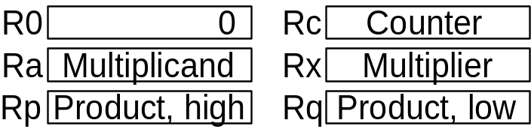
9.2 Programmed Multiplication
{Using right shifts, multiply unsigned m_cand and m_ier,
storing the resultant 2k-bit product in p_high and p_low.
Registers: R0 holds 0 Rc for counter
Ra for m_cand Rx for m_ier
Rp for p_high Rq for p_low}
{Load operands into registers Ra and Rx}
mult: load Ra with m_cand
load Rx with m_ier
{Initialize partial product and counter}
copy R0 into Rp
copy R0 into Rq
load k into Rc
{Begin multiplication loop}
m_loop: shift Rx right 1 {LSB moves to carry flag}
branch no_add if carry = 0
add Ra to Rp {carry flag is set to cout}
no_add: rotate Rp right 1 {carry to MSB, LSB to carry}
rotate Rq right 1 {carry to MSB, LSB to carry}
decr Rc {decrement counter by 1}
branch m_loop if Rc ≠ 0
{Store the product}
store Rp into p_high
store Rq into p_low
m_done: ...
Fig. 9.3 Programmed multiplication (right-shift algorithm).
Apr. 2020
Computer Arithmetic, Multiplication
Slide <number>

Slide 13
Time Complexity of Programmed Multiplication
Assume k-bit words
k iterations of the main loop
6-7 instructions per iteration, depending on the multiplier bit
Thus, 6k + 3 to 7k + 3 machine instructions,
ignoring operand loads and result store
k = 32 implies 200⁺ instructions on average
This is too slow for many modern applications!
Microprogrammed multiply would be somewhat better
Apr. 2020
Computer Arithmetic, Multiplication
Slide <number>

Slide 14
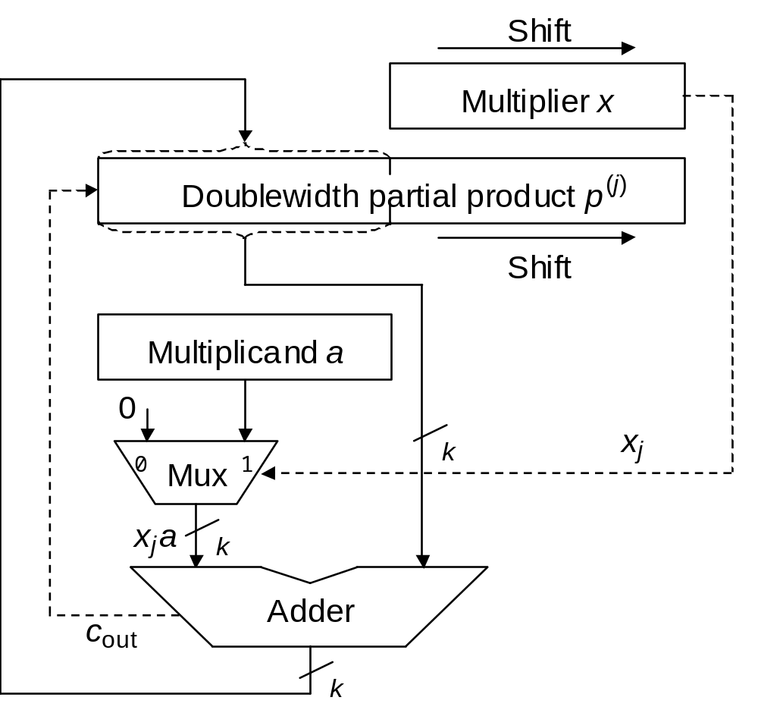
9.3 Basic Hardware Multipliers
p^{(j+1)} = (p^{(j)} + x_{j} a 2^{k}) 2^{–1}
|–––add–––|
|––shift right––|
Fig. 9.4 Hardware realization of the sequential multiplication algorithm with additions and right shifts.
Apr. 2020
Computer Arithmetic, Multiplication
Slide <number>

Slide 15
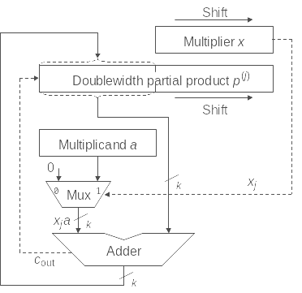
Example of Hardware Multiplication
1 0 1 1
1 0 1
1 0
1
(11)_{ten}
0 0 0 0
1 0 1 0
0 1 0 1 0
1 1 1 1 0
0 1 1 1 1 0
0 0 1 1 1 1 0
1 1 0 1 1 1 0
0 1 1 0 1 1 1 0
(110)_{ten}
1 0 1 0
(10)_{ten}
p^{(j+1)} = (p^{(j)} + x_{j} a 2^{k}) 2^{–1}
|–––add–––|
|––shift right––|
Fig. 9.4a Hardware realization of the sequential multiplication algorithm with additions and right shifts.
Apr. 2020
Computer Arithmetic, Multiplication
Slide <number>

Slide 16
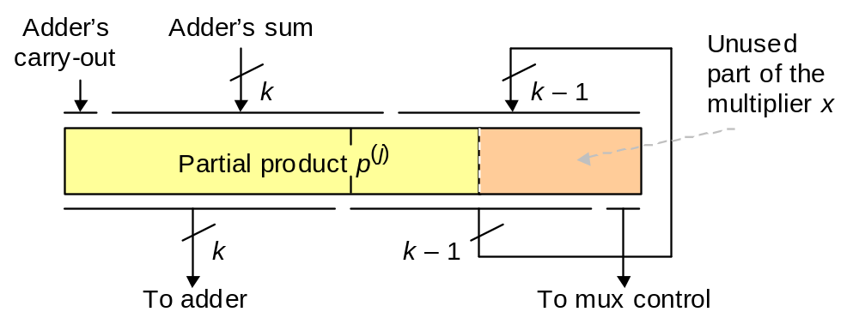
Performing Add and Shift in One Clock Cycle
Fig. 9.5 Combining the loading and shifting of the double-width register holding the partial product and the partially used multiplier.
Apr. 2020
Computer Arithmetic, Multiplication
Slide <number>

Slide 17
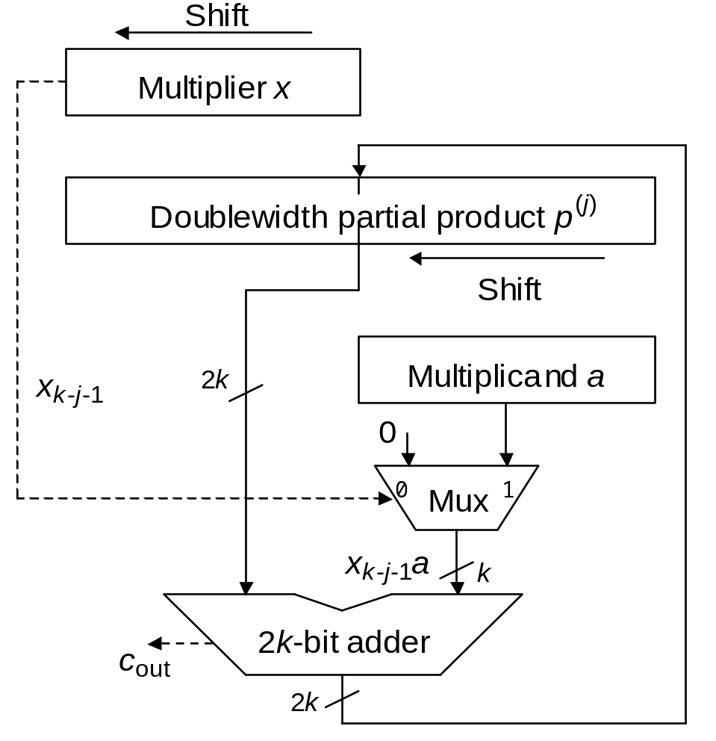
Sequential Multiplication with Left Shifts
Fig. 9.4b Hardware realization of the sequential multiplication algorithm with left shifts and additions.
Apr. 2020
Computer Arithmetic, Multiplication
Slide <number>

Slide 18
9.4 Multiplication of Signed Numbers
============================
a 1 0 1 1 0
x 0 1 0 1 1
============================
p⁽⁰⁾ 0 0 0 0 0
+x₀a 1 0 1 1 0
–––––––––––––––––––––––––––––
2p⁽¹⁾ 1 1 0 1 1 0
p⁽¹⁾ 1 1 0 1 1 0
+x₁a 1 0 1 1 0
–––––––––––––––––––––––––––––
2p⁽²⁾ 1 1 0 0 0 1 0
p⁽²⁾ 1 1 0 0 0 1 0
+x₂a 0 0 0 0 0
–––––––––––––––––––––––––––––
2p⁽³⁾ 1 1 1 0 0 0 1 0
p⁽³⁾ 1 1 1 0 0 0 1 0
+x₃a 1 0 1 1 0
–––––––––––––––––––––––––––––
2p⁽⁴⁾ 1 1 0 0 1 0 0 1 0
p⁽⁴⁾ 1 1 0 0 1 0 0 1 0
+x₄a 0 0 0 0 0
–––––––––––––––––––––––––––––
2p⁽⁵⁾ 1 1 1 0 0 1 0 0 1 0
p⁽⁵⁾ 1 1 1 0 0 1 0 0 1 0
============================
Check:
–10 × 11
= –110
= –512 +
256 +
128 +
16 + 2
Fig. 9.6 Sequential multiplication of
2’s-complement numbers with right shifts (positive multiplier).
Negative multiplicand,
positive multiplier:
No change, other than
looking out for proper
sign extension
Apr. 2020
Computer Arithmetic, Multiplication
Slide <number>

Slide 19
The Case of a Negative Multiplier
============================
a 1 0 1 1 0
x 1 0 1 0 1
============================
p⁽⁰⁾ 0 0 0 0 0
+x₀a 1 0 1 1 0
–––––––––––––––––––––––––––––
2p⁽¹⁾ 1 1 0 1 1 0
p⁽¹⁾ 1 1 0 1 1 0
+x₁a 0 0 0 0 0
–––––––––––––––––––––––––––––
2p⁽²⁾ 1 1 1 0 1 1 0
p⁽²⁾ 1 1 1 0 1 1 0
+x₂a 1 0 1 1 0
–––––––––––––––––––––––––––––
2p⁽³⁾ 1 1 0 0 1 1 1 0
p⁽³⁾ 1 1 0 0 1 1 1 0
+x₃a 0 0 0 0 0
–––––––––––––––––––––––––––––
2p⁽⁴⁾ 1 1 1 0 0 1 1 1 0
p⁽⁴⁾ 1 1 1 0 0 1 1 1 0
+(−x₄a) 0 1 0 1 0
–––––––––––––––––––––––––––––
2p⁽⁵⁾ 0 0 0 1 1 0 1 1 1 0
p⁽⁵⁾ 0 0 0 1 1 0 1 1 1 0
============================
Check:
–10 × –11
= 110
= 64 + 32 +
8 + 4 + 2
Fig. 9.7 Sequential multiplication of
2’s-complement numbers with right shifts (negative multiplier).
Negative multiplicand,
negative multiplier:
In last step (the sign bit), subtract rather than add
Apr. 2020
Computer Arithmetic, Multiplication
Slide <number>

Slide 20
Signed 2’s-Complement Hardware Multiplier
Multiplier
Partial product
k + 1
Multiplicand
1
0
Enable
Mux
Select
k + 1
Adder
c_{out}
c_{in}
0, except in last cycle
k + 1
Fig. 9.8 The 2’s-complement sequential hardware multiplier.
Apr. 2020
Computer Arithmetic, Multiplication
Slide <number>

Slide 21
Booth’s Recoding
Table 9.1 Radix-2 Booth’s recoding
–––––––––––––––––––––––––––––––––––––
x_{i} x_{i–1} y_{i} Explanation
–––––––––––––––––––––––––––––––––––––
0 0 0 No string of 1s in sight
0 1 1 End of string of 1s in x
1 0 ⁻1 Beginning of string of 1s in x
1 1 0 Continuation of string of 1s in x
–––––––––––––––––––––––––––––––––––––
Example
1 0 0 1 1 1 0 1 1 0 1 0 1 1 1 0 Operand x
(1) ⁻1 0 1 0 0 ⁻1 1 0 ⁻1 1 ⁻1 1 0 0 ⁻1 0 Recoded version y
Justification
2^{j} + 2^{j–1} + . . . + 2^{i+1} + 2^{i} = 2^{j+1} – 2^{i}
Apr. 2020
Computer Arithmetic, Multiplication
Slide <number>

Slide 22
Example Multiplication with Booth’s Recoding
============================
a 1 0 1 1 0
x 1 0 1 0 1 Multiplier
y ⁻1 1 ⁻1 1 ⁻1 Booth-recoded
============================
p⁽⁰⁾ 0 0 0 0 0
+y₀a 0 1 0 1 0
–––––––––––––––––––––––––––––
2p⁽¹⁾ 0 0 1 0 1 0
p⁽¹⁾ 0 0 1 0 1 0
+y₁a 1 0 1 1 0
–––––––––––––––––––––––––––––
2p⁽²⁾ 1 1 1 0 1 1 0
p⁽²⁾ 1 1 1 0 1 1 0
+y₂a 0 1 0 1 0
–––––––––––––––––––––––––––––
2p⁽³⁾ 0 0 0 1 1 1 1 0
p⁽³⁾ 0 0 0 1 1 1 1 0
+y₃a 1 0 1 1 0
–––––––––––––––––––––––––––––
2p⁽⁴⁾ 1 1 1 0 0 1 1 1 0
p⁽⁴⁾ 1 1 1 0 0 1 1 1 0
y₄a 0 1 0 1 0
–––––––––––––––––––––––––––––
2p⁽⁵⁾ 0 0 0 1 1 0 1 1 1 0
p⁽⁵⁾ 0 0 0 1 1 0 1 1 1 0
============================
Check:
–10 × –11
= 110
= 64 + 32 +
8 + 4 + 2
Fig. 9.9 Sequential multiplication of
2’s-complement numbers with right shifts by means of Booth’s recoding.
––––––––––
x_{i} x_{i–1} y_{i}
––––––––––
0 0 0
0 1 1
1 0 ⁻1
1 1 0
––––––––––
Apr. 2020
Computer Arithmetic, Multiplication
Slide <number>

Slide 23
9.5 Multiplication by Constants
0 1 2 . . . n – 1
Explicit, e.g. y := 12 ∗ x + 1
Implicit, e.g. A[i, j] := A[i, j] + B[i, j]
Address of A[i, j] = base + n ∗ i + j
0
1
2
.
.
.
m – 1
Row i
Column j
Software aspects:
Optimizing compilers replace multiplications by shifts/adds/subs
Produce efficient code using as few registers as possible
Find the best code by a time/space-efficient algorithm
Hardware aspects:
Synthesize special-purpose units such as filters
y[t] = a₀x[t] + a₁x[t – 1] + a₂x[t – 2] + b₁y[t – 1] + b₂y[t – 2]
Apr. 2020
Computer Arithmetic, Multiplication
Slide <number>

Slide 24
Multiplication Using Binary Expansion
Example: Multiply R1 by the constant 113 = (1 1 1 0 0 0 1)_{two}
R2 ← R1 shift-left 1
R3 ← R2 + R1
R6 ← R3 shift-left 1
R7 ← R6 + R1
R112 ← R7 shift-left 4
R113 ← R112 + R1
Shift, add
Shift
Ri: Register that contains i times (R1)
This notation is for clarity; only one register other than R1 is needed
Shorter sequence using shift-and-add instructions
R3 ← R1 shift-left 1 + R1
R7 ← R3 shift-left 1 + R1
R113 ← R7 shift-left 4 + R1
Apr. 2020
Computer Arithmetic, Multiplication
Slide <number>

Slide 25
Multiplication via Recoding
Example: Multiply R1 by 113 = (1 1 1 0 0 0 1)_{two} = (1 0 0⁻1 0 0 0 1)_{two}
R8 ← R1 shift-left 3
R7 ← R8 – R1
R112 ← R7 shift-left 4
R113 ← R112 + R1
Shift
Shift, subtract
Shift, add
Shorter sequence using shift-and-add/subtract instructions
R7 ← R1 shift-left 3 – R1
R113 ← R7 shift-left 4 + R1
6 shift or add (3 shift-and-add) instructions needed without recoding
The canonic signed-digit representation of a number contains no consecutive nonzero digits: average number of shift-adds is O(k/3)
Apr. 2020
Computer Arithmetic, Multiplication
Slide <number>

Slide 26
Multiplication via Factorization
Example: Multiply R1 by 119 = 7 × 17
= (8 – 1) × (16 + 1)
R8 ← R1 shift-left 3
R7 ← R8 – R1
R112 ← R7 shift-left 4
R119 ← R112 + R7
128x
8x
x
CSA
1
CPA
1
119x
Shorter sequence using shift-and-add/subtract instructions
R7 ← R1 shift-left 3 – R1
R119 ← R7 shift-left 4 + R7
Requires a scratch register for holding the 7 multiple
119 = (1 1 1 0 1 1 1)_{two} = (1 0 0 0⁻1 0 0⁻1)_{two}
More instructions may be needed without factorization
Apr. 2020
Computer Arithmetic, Multiplication
Slide <number>

Slide 27
Multiplication by Multiple Constants
Example: Multiplying a number by 45, 49, and 65
R9 ← R1 shift-left 3 + R1
R45 ← R9 shift-left 2 + R9
R7 ← R1 shift-left 3 – R1
R49 ← R7 shift-left 3 – R7
R65 ← R1 shift-left 6 + R1
Separate solutions:
5 shift-add/subtract
operations
A combined solution for all three constants
R65 ← R1 shift-left 6 + R1
R49 ← R65 – R1 left-shift 4
R45 ← R49 – R1 left-shift 2
A programmable block can perform any of the three multiplications
Apr. 2020
Computer Arithmetic, Multiplication
Slide <number>

Slide 28
9.6 Preview of Fast Multipliers
Viewing multiplication as a multioperand addition problem,
there are but two ways to speed it up
a. Reducing the number of operands to be added:
Handling more than one multiplier bit at a time
(high-radix multipliers, Chapter 10)
b. Adding the operands faster:
Parallel/pipelined multioperand addition
(tree and array multipliers, Chapter 11)
In Chapter 12, we cover all remaining multiplication topics:
Bit-serial multipliers
Modular multipliers
Multiply-add units
Squaring as a special case
Apr. 2020
Computer Arithmetic, Multiplication
Slide <number>

Slide 29
10 High-Radix Multipliers
Chapter Goals
Study techniques that allow us to handle
more than one multiplier bit in each cycle
(two bits in radix 4, three in radix 8, . . .)
Chapter Highlights
High radix gives rise to “difficult” multiples
Recoding (change of digit-set) as remedy
Carry-save addition reduces cycle time
Implementation and optimization methods
Apr. 2020
Computer Arithmetic, Multiplication
Slide <number>

Slide 30
High-Radix Multipliers: Topics
Topics in This Chapter
10.1 Radix-4 Multiplication
10.2 Modified Booth’s Recoding
10.3 Using Carry-Save Adders
10.4 Radix-8 and Radix-16 Multipliers
10.5 Multibeat Multipliers
10.6 VLSI Complexity Issues
Apr. 2020
Computer Arithmetic, Multiplication
Slide <number>

Slide 31
10.1 Radix-4 Multiplication
Fig. 9.1 (modified)
x₀ a r ⁰
x₁ a r ¹
x₂ a r ²
x₃ a r ³
Preferred
Multiplication with right shifts in radix r : top-to-bottom accumulation
p^{(j+1)} = (p^{(j)} + x_{j} a r ^{k}) r ^{–1} with p⁽⁰⁾ = 0 and
|–––add–––| p^{(k)} = p = ax + p⁽⁰⁾r ^{–k}
|––shift right––|
Multiplication with left shifts in radix r : bottom-to-top accumulation
p^{(j+1)} = r p^{(j)} + x_{k–j–1}a with p⁽⁰⁾ = 0 and
|shift| p^{(k)} = p = ax + p⁽⁰⁾r ^{k}
|––––add––––|
Apr. 2020
Computer Arithmetic, Multiplication
Slide <number>

Slide 32
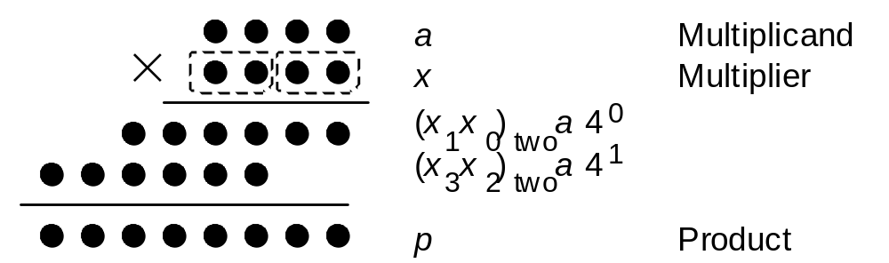
Radix-4 Multiplication in Dot Notation
Fig. 10.1 Radix-4, or two-bit-at-a-time, multiplication in dot notation
Fig. 9.1
Number of cycles is halved, but now the “difficult” multiple 3a must be dealt with
Apr. 2020
Computer Arithmetic, Multiplication
Slide <number>

Slide 33
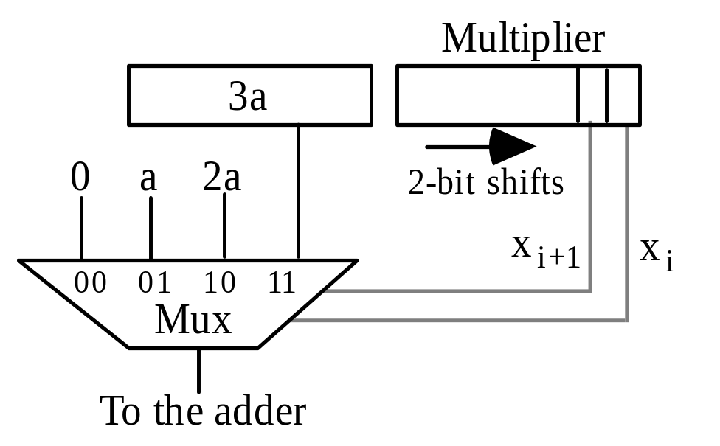
A Possible Design for a Radix-4 Multiplier
Precomputed via shift-and-add
(3a = 2a + a)
k/2 + 1 cycles, rather than k
One extra cycle over k/2
not too bad, but we would like to avoid it if possible
Solving this problem for radix 4 may also help when dealing with even higher radices
Fig. 10.2 The multiple generation part of a radix-4 multiplier with precomputation of 3a.
Apr. 2020
Computer Arithmetic, Multiplication
Slide <number>

Slide 34
Example Radix-4 Multiplication Using 3a
================================
a 0 1 1 0
3a 0 1 0 0 1 0
x 1 1 1 0
================================
p⁽⁰⁾ 0 0 0 0
+(x₁x₀)_{two}a 0 0 1 1 0 0
–––––––––––––––––––––––––––––––––
4p⁽¹⁾ 0 0 1 1 0 0
p⁽¹⁾ 0 0 1 1 0 0
+(x₃x₂)_{two}a 0 1 0 0 1 0
–––––––––––––––––––––––––––––––––
4p⁽²⁾ 0 1 0 1 0 1 0 0
p⁽²⁾ 0 1 0 1 0 1 0 0
================================
Fig. 10.3 Example of radix-4 multiplication using the 3a multiple.
Apr. 2020
Computer Arithmetic, Multiplication
Slide <number>

Slide 35
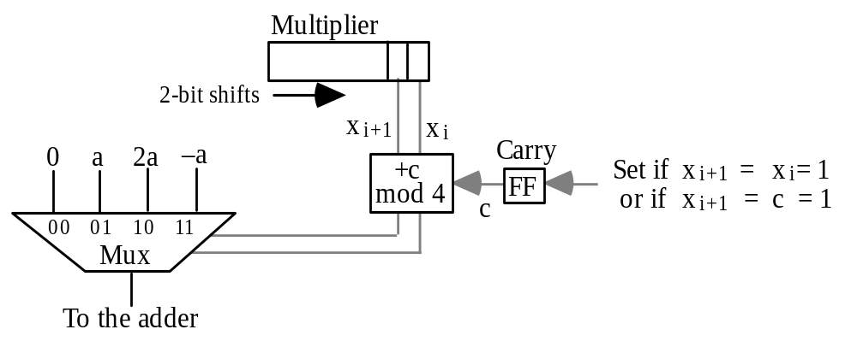
A Second Design for a Radix-4 Multiplier
Fig. 10.4 The multiple generation part of a radix-4 multiplier based on replacing 3a with 4a (carry into next higher radix-4 multiplier digit) and –a.
c
x_{i+1}(x_{i} ∨ c)
x_{i+1} ⊕ x_{i} c
x_{i} ⊕ c
x_{i+1} x_{i} c Mux control Set carry
---- --- --- ---------------- ------------
0 0 0 0 0 0
0 0 1 0 1 0
0 1 0 0 1 0
0 1 1 1 0 0
1 0 0 1 0 0
1 0 1 1 1 1
1 1 0 1 1 1
1 1 1 0 0 1
Apr. 2020
Computer Arithmetic, Multiplication
Slide <number>

Slide 36
10.2 Modified Booth’s Recoding
Table 10.1 Radix-4 Booth’s recoding yielding (z_{k/2} . . . z₁z₀)_{four}
–––––––––––––––––––––––––––––––––––––––––––––––––––––––––––––––––
x_{i+1} x_{i} x_{i–1} y_{i+1} y_{i} z_{i/2} Explanation
–––––––––––––––––––––––––––––––––––––––––––––––––––––––––––––––––
0 0 0 0 0 0 No string of 1s in sight
0 0 1 0 1 1 End of string of 1s
0 1 0 0 1 1 Isolated 1
0 1 1 1 0 2 End of string of 1s
1 0 0 ⁻1 0 ⁻2 Beginning of string of 1s
1 0 1 ⁻1 1 ⁻1 End a string, begin new one
1 1 0 0 ⁻1 ⁻1 Beginning of string of 1s
1 1 1 0 0 0 Continuation of string of 1s
–––––––––––––––––––––––––––––––––––––––––––––––––––––––––––––––––
Recoded radix-2 digits
Context
Radix-4 digit
Example
1 0 0 1 1 1 0 1 1 0 1 0 1 1 1 0 Operand x
(1) ⁻1 0 1 0 0 ⁻1 1 0 ⁻1 1 ⁻1 1 0 0 ⁻1 0 Recoded version y
(1) ⁻2 2 ⁻1 2 ⁻1 ⁻1 0 ⁻2 Radix-4 version z
Apr. 2020
Computer Arithmetic, Multiplication
Slide <number>

Slide 37
Example Multiplication via Modified Booth’s Recoding
================================
a 0 1 1 0
x 1 0 1 0
z ⁻1 ⁻2 Radix-4
================================
p⁽⁰⁾ 0 0 0 0 0 0
+z₀a 1 1 0 1 0 0
–––––––––––––––––––––––––––––––––
4p⁽¹⁾ 1 1 0 1 0 0
p⁽¹⁾ 1 1 1 1 0 1 0 0
+z₁a 1 1 1 0 1 0
–––––––––––––––––––––––––––––––––
4p⁽²⁾ 1 1 0 1 1 1 0 0
p⁽²⁾ 1 1 0 1 1 1 0 0
================================
Fig. 10.5 Example of radix-4 multiplication with modified Booth’s recoding of the 2’s-complement multiplier.
Apr. 2020
Computer Arithmetic, Multiplication
Slide <number>

Slide 38
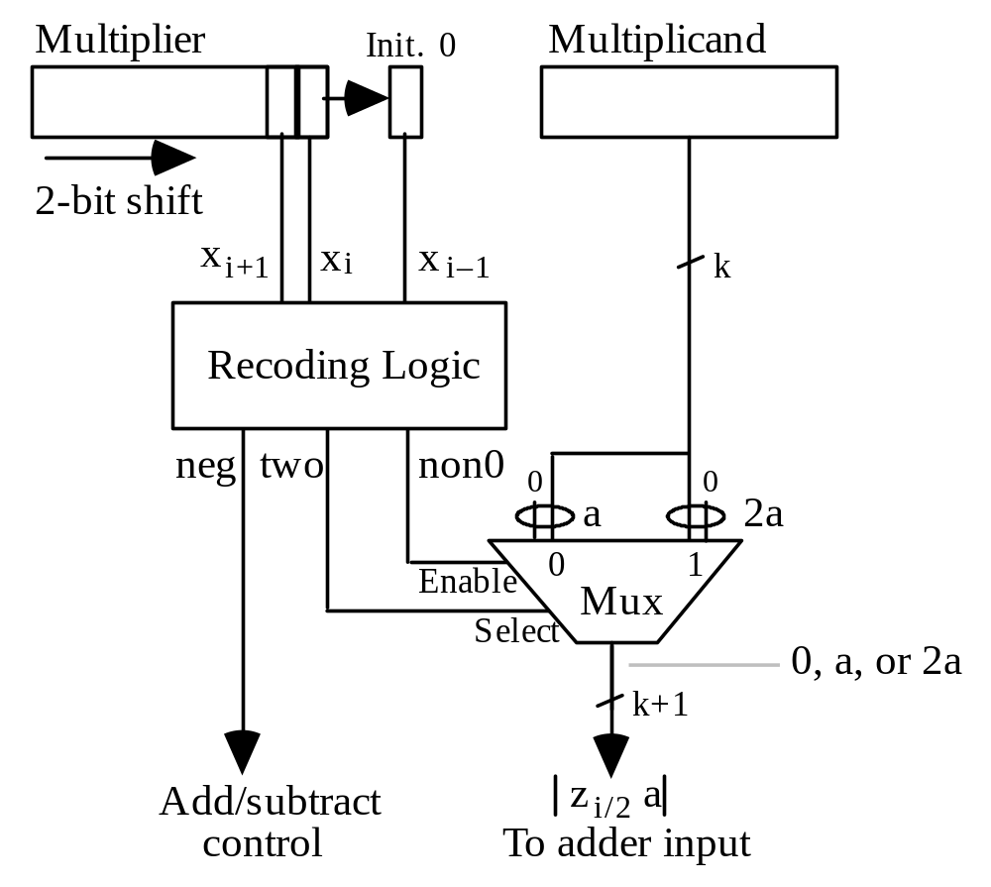
Multiple Generation with Radix-4 Booth’s Recoding
---- Encoding ----
Digit neg two non0
–2 1 1 1
–1 1 0 1
0 0 0 0
1 0 0 1
2 0 1 1
Sign
of a
Could have named
this signal one/two
Fig. 10.6 The multiple generation part of a radix-4 multiplier based on Booth’s recoding.
Apr. 2020
Computer Arithmetic, Multiplication
Slide <number>

Slide 39
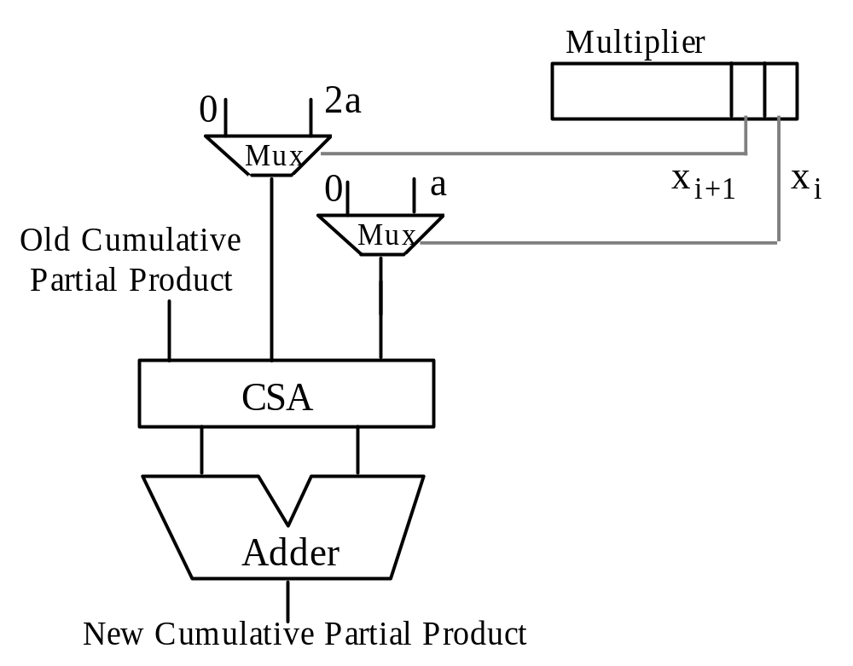
10.3 Using Carry-Save Adders
Fig. 10.7 Radix-4 multiplication with a carry-save adder used to combine the cumulative partial product, x_{i}a, and 2x_{i+1}a into two numbers.
Apr. 2020
Computer Arithmetic, Multiplication
Slide <number>

Slide 40
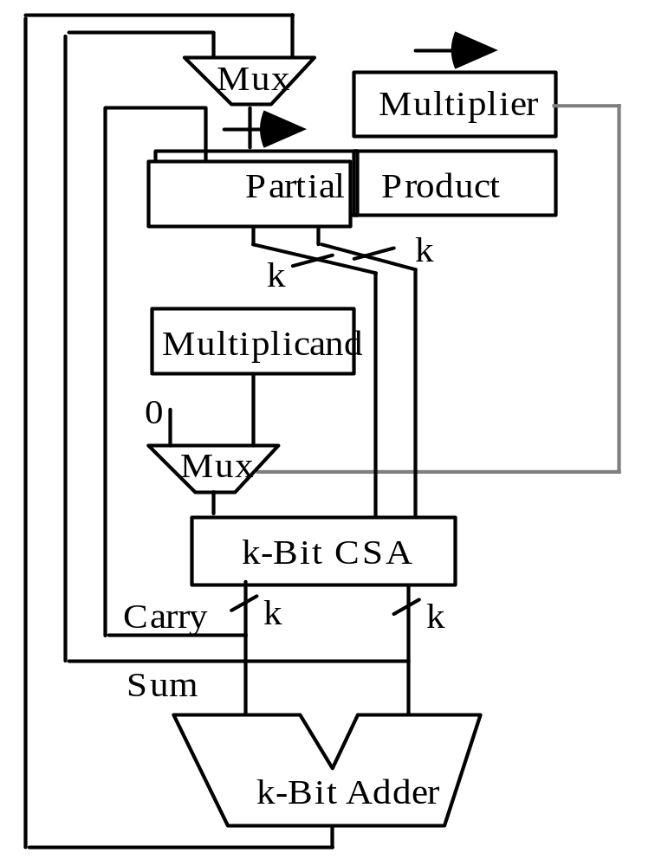
Keeping the Partial Product in Carry-Save Form
Sum
Carry
Sum
Carry
Right shift
Upper half of PP
Lower half of PP
(a) Multiplier block diagram
(b) Operation in a typical cycle
Fig. 10.8 Radix-2 multiplication with the upper half of the cumulative partial product kept in stored-carry form.
Apr. 2020
Computer Arithmetic, Multiplication
Slide <number>

Slide 41
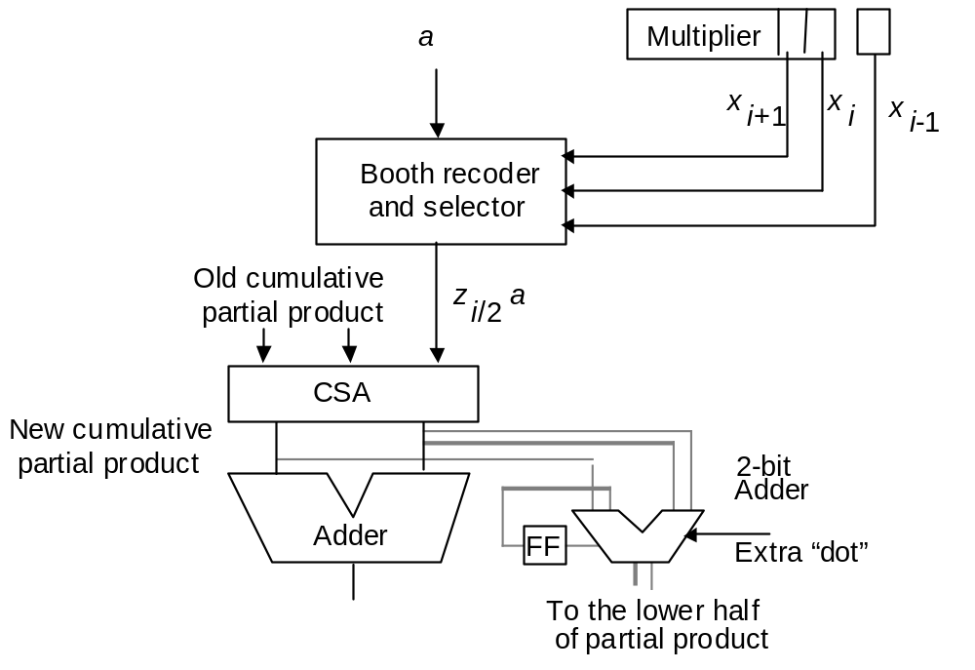
Carry-Save Multiplier with Radix-4 Booth’s Recoding
Fig. 10.9 Radix-4 multiplication with a CSA used to combine the stored-carry cumulative partial product and z_{i/2}a into two numbers.
Apr. 2020
Computer Arithmetic, Multiplication
Slide <number>

Slide 42
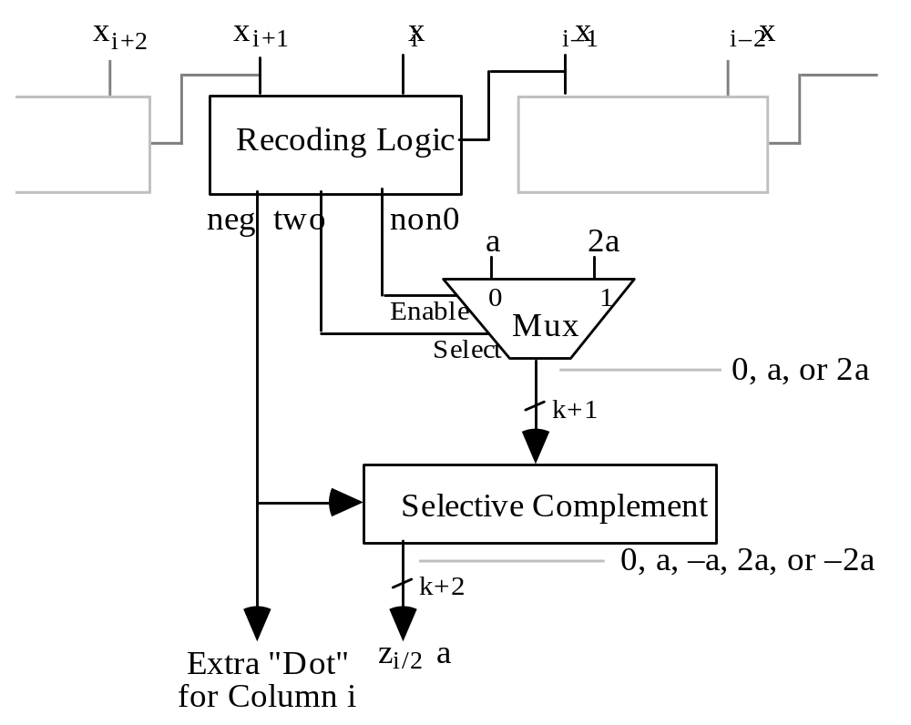
Radix-4 Booth’s Recoding for Parallel Multiplication
Fig. 10.10 Booth recoding and multiple selection logic for
high-radix or parallel multiplication.
Apr. 2020
Computer Arithmetic, Multiplication
Slide <number>

Slide 43
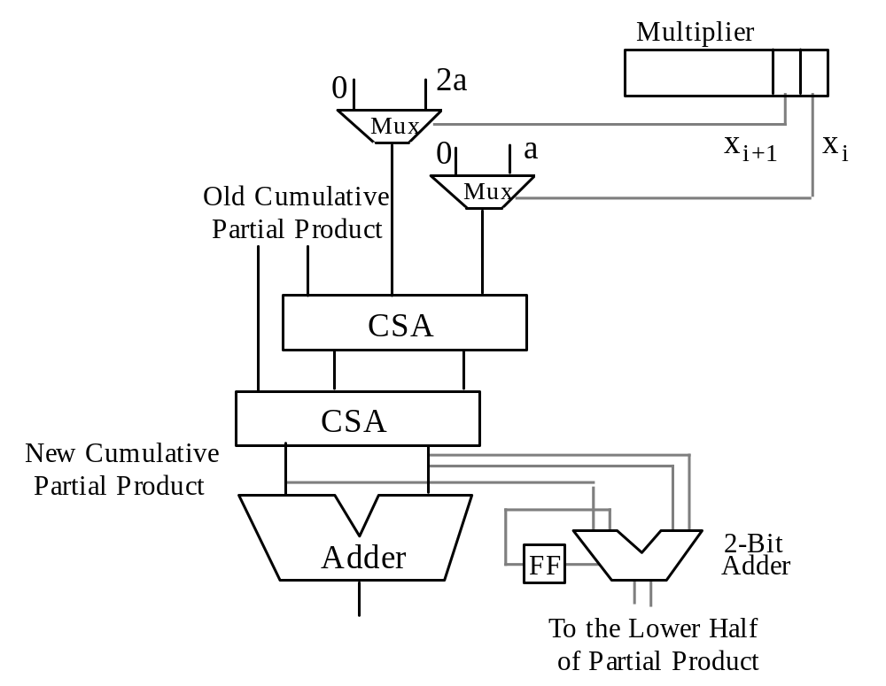
Yet Another Design for Radix-4 Multiplication
(4; 2)-counter
Fig. 10.11 Radix-4 multiplication, with the cumulative partial product, x_{i}a, and 2x_{i+1}a combined into two numbers by two CSAs.
Apr. 2020
Computer Arithmetic, Multiplication
Slide <number>

Slide 44
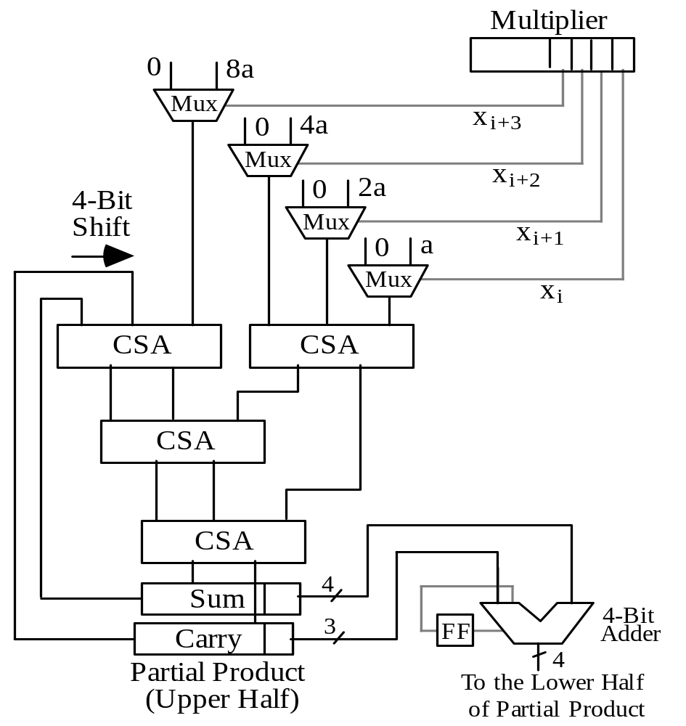
10.4 Radix-8 and Radix-16 Multipliers
4-bit
right
shift
Fig. 10.12 Radix-16 multiplication with the upper half of the cumulative partial product in carry-save form.
Apr. 2020
Computer Arithmetic, Multiplication
Slide <number>

Slide 45
Other High-Radix Multipliers
Remove this mux & CSA and replace the 4-bit shift (adder) with a 3-bit shift (adder) to get a radix-8 multiplier (cycle time will remain the same, though)
A radix-16 multiplier design becomes a radix-256 multiplier if radix-4 Booth’s recoding is applied first
(the muxes are replaced by Booth recoding and multiple selection logic)
Fig. 10.12
Apr. 2020
Computer Arithmetic, Multiplication
Slide <number>

Slide 46
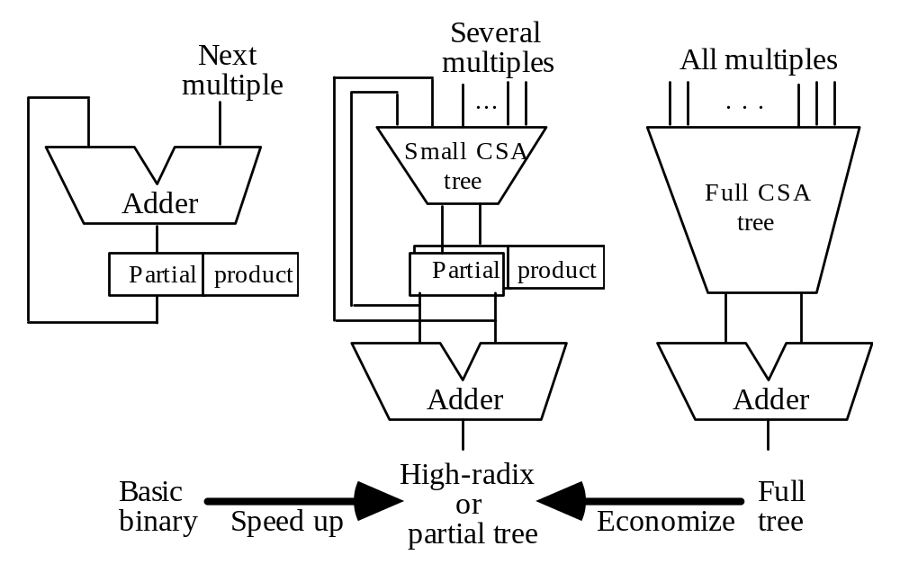
A Spectrum of Multiplier Design Choices
Fig. 10.13 High-radix multipliers as intermediate between sequential radix-2 and full-tree multipliers.
Apr. 2020
Computer Arithmetic, Multiplication
Slide <number>

Slide 47
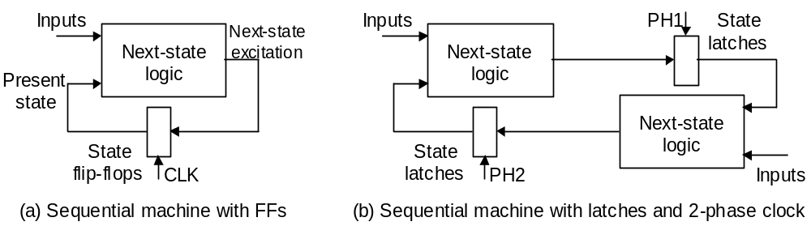
10.5 Multibeat Multipliers
Fig. 10.15 Two-phase clocking for sequential logic.
Begin changing FF contents
Change becomes visible at FF output
Observation: Half of the clock cycle goes to waste
Once cycle
Apr. 2020
Computer Arithmetic, Multiplication
Slide <number>

Slide 48
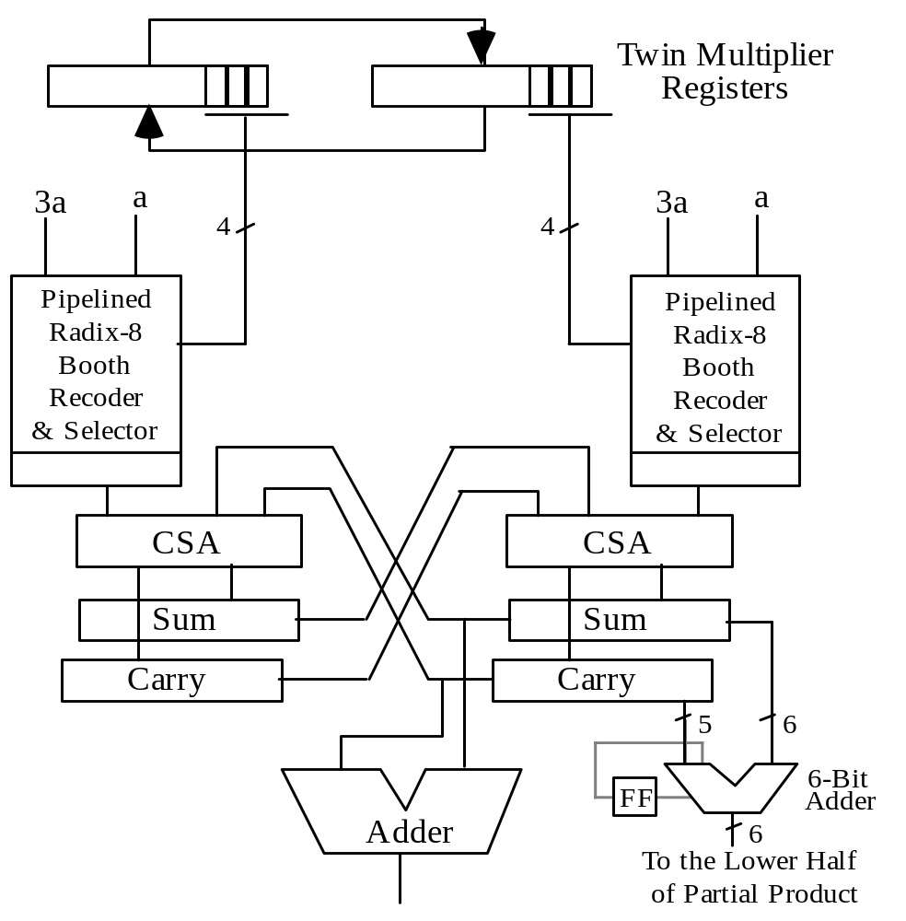
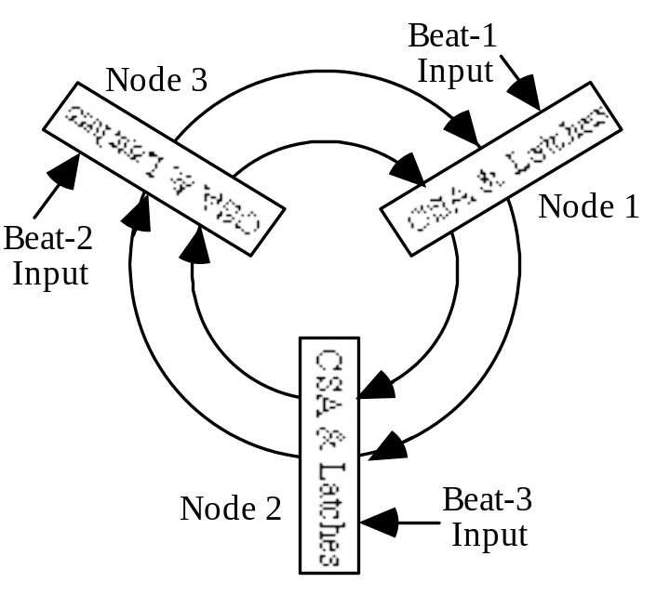
Twin-Beat and Three-Beat Multipliers
This radix-64 multiplier runs at the clock rate of a radix-8 design (2X speed)
Fig. 10.14 Twin-beat multiplier with radix-8 Booth’s recoding.
Fig. 10.16 Conceptual view of a three-beat multiplier.
Apr. 2020
Computer Arithmetic, Multiplication
Slide <number>

Slide 49
10.6 VLSI Complexity Issues
A radix-2^{b} multiplier requires:
bk two-input AND gates to form the partial products bit-matrix
O(bk) area for the CSA tree
At least Θ(k) area for the final carry-propagate adder
Total area: A = O(bk)
Latency: T = O((k/b) log b + log k)
Any VLSI circuit computing the product of two k-bit integers must satisfy the following constraints:
AT grows at least as fast as k^{3/2}
AT² is at least proportional to k²
The preceding radix-2^{b} implementations are suboptimal, because:
AT = O(k² log b + bk log k)
AT² = O((k³/b) log²b)
Apr. 2020
Computer Arithmetic, Multiplication
Slide <number>

Slide 50
Comparing High- and Low-Radix Multipliers
AT = O(k² log b + bk log k) AT ² = O((k³/b) log²b)
 | Low-Cost b = O(1) | High Speed b = O(k) | AT- or AT ²- Optimal
AT | O(k ²) | O(k ² log k) | O(k ^{3/2})
AT ² | O(k ³) | O(k ² log² k) | O(k ²)
Intermediate designs do not yield better AT or AT ² values;
The multipliers remain asymptotically suboptimal for any b
By the AT measure (indicator of cost-effectiveness), slower radix-2 multipliers are better than high-radix or tree multipliers
Thus, when an application requires many independent multiplications, it is more cost-effective to use a large number of slower multipliers
High-radix multiplier latency can be reduced from O((k/b) log b + log k) to O(k/b + log k) through more effective pipelining (Chapter 11)
Apr. 2020
Computer Arithmetic, Multiplication
Slide <number>

Slide 51
11 Tree and Array Multipliers
Chapter Goals
Study the design of multipliers for highest
possible performance (speed, throughput)
Chapter Highlights
Tree multiplier = reduction tree
+ redundant-to-binary converter
Avoiding full sign extension in multiplying
signed numbers
Array multiplier = one-sided reduction tree
+ ripple-carry adder
Apr. 2020
Computer Arithmetic, Multiplication
Slide <number>

Slide 52
Tree and Array Multipliers: Topics
Topics in This Chapter
11.1. Full-Tree Multipliers
11.2. Alternative Reduction Trees
11.3. Tree Multipliers for Signed Numbers
11.4. Partial-Tree and Truncated Multipliers
11.5. Array Multipliers
11.6. Pipelined Tree and Array Multipliers
Apr. 2020
Computer Arithmetic, Multiplication
Slide <number>

Slide 53
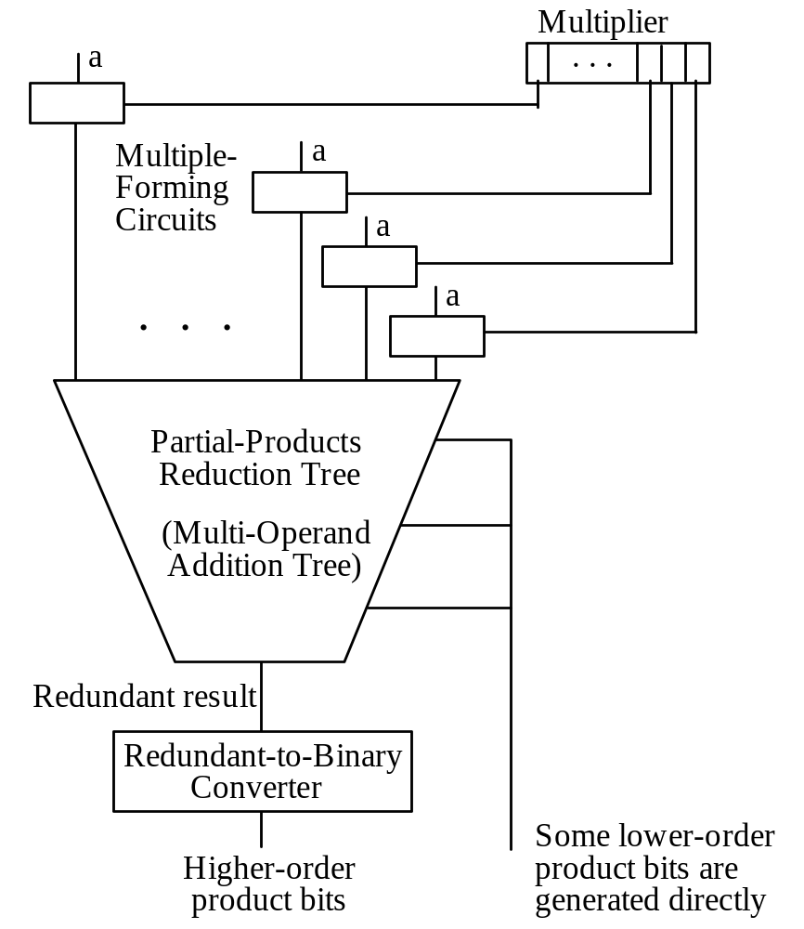
11.1 Full-Tree Multipliers
Fig. 10.13 High-radix multipliers as intermediate between sequential radix-2 and full-tree multipliers.
Fig. 11.1 General structure of a full-tree multiplier.
Apr. 2020
Computer Arithmetic, Multiplication
Slide <number>

Slide 54
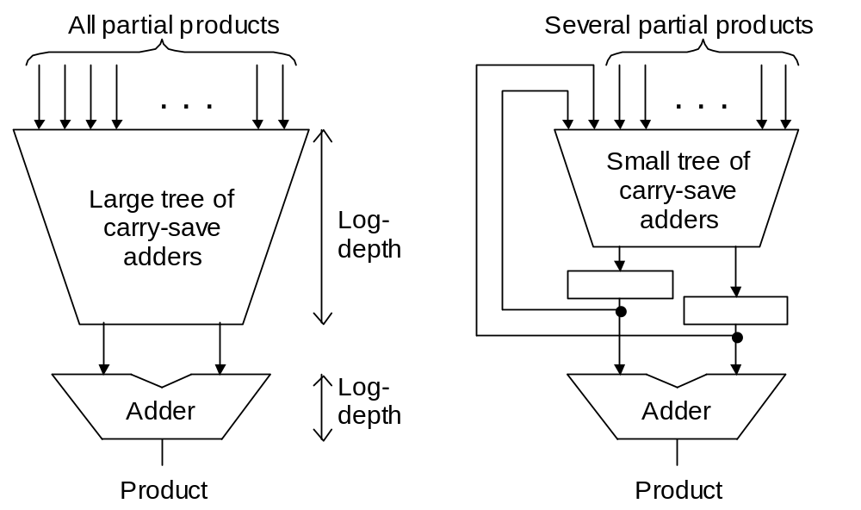
Full-Tree versus Partial-Tree Multiplier
Schematic diagrams for full-tree and partial-tree multipliers.
Apr. 2020
Computer Arithmetic, Multiplication
Slide <number>

Slide 55
Variations in Full-Tree Multiplier Design
Designs are distinguished by
variations in three elements:
1. Multiple-forming circuits
2. Partial products reduction tree
Fig. 11.1
3. Redundant-to-binary converter
Apr. 2020
Computer Arithmetic, Multiplication
Slide <number>

Slide 56
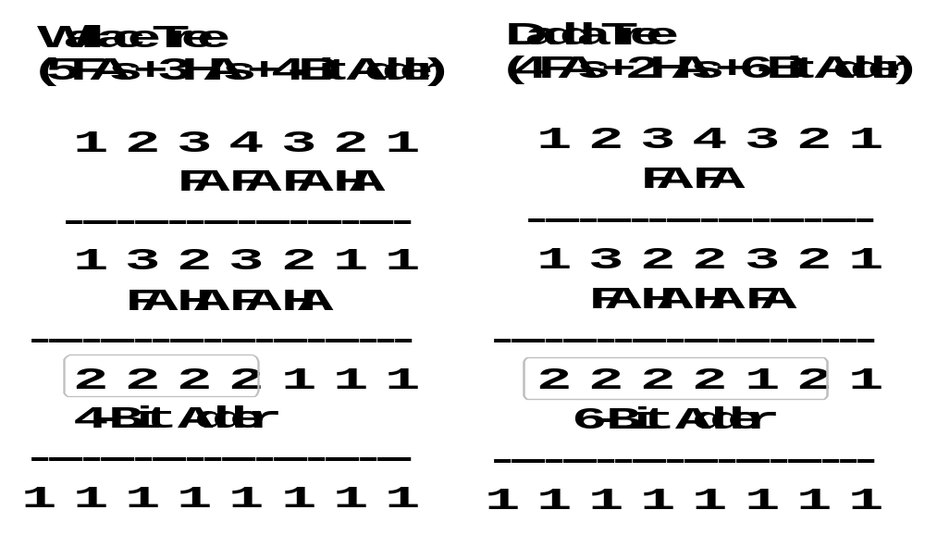
Example of Variations in CSA Tree Design
Corrections
shown in red
HA
HA
3
3
FA
FA
HA
2
Fig. 11.2 Two different binary 4 × 4 tree multipliers.
Apr. 2020
Computer Arithmetic, Multiplication
Slide <number>

Slide 57
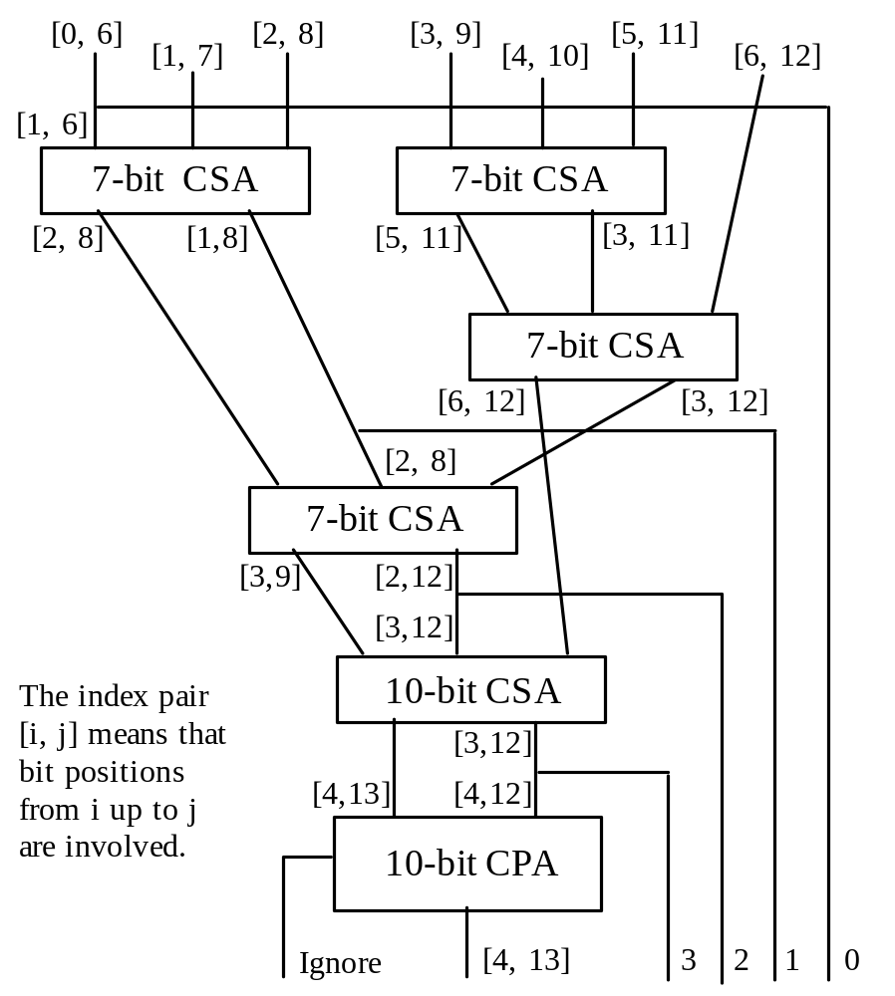
Details of a CSA Tree
Fig. 11.3 Possible CSA tree for a 7 × 7 tree multiplier.
CSA trees are quite irregular, causing some difficulties in VLSI realization
Thus, our motivation to examine alternate methods for partial products reduction
Apr. 2020
Computer Arithmetic, Multiplication
Slide <number>

Slide 58
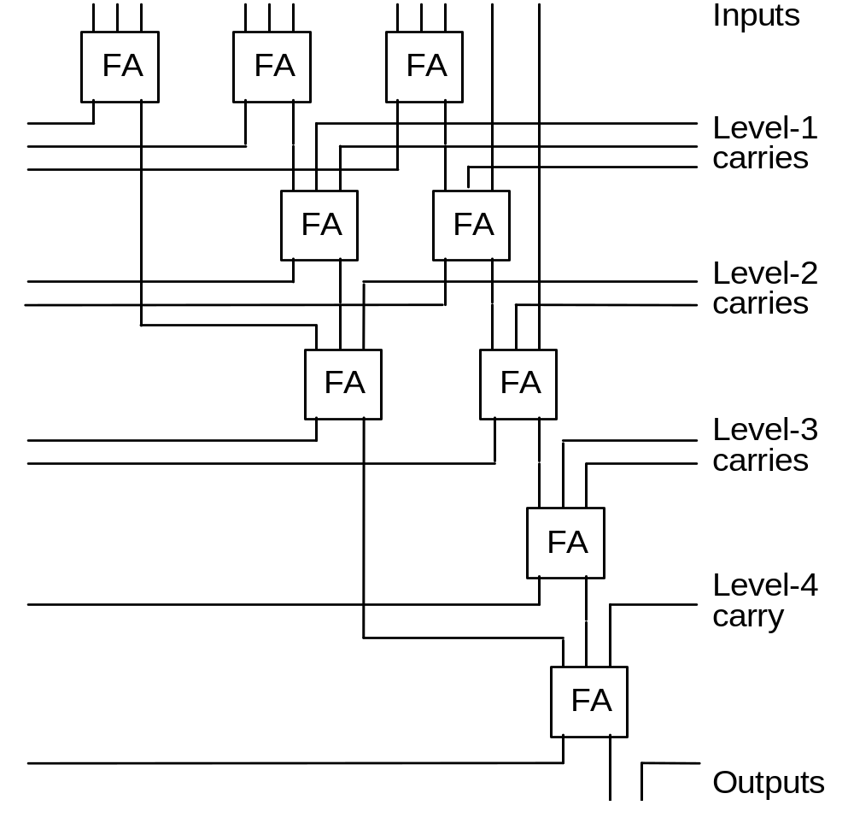
11.2 Alternative Reduction Trees
FA
FA
Level
1
FA
11 + ψ₁ = 2ψ₁ + 3
Therefore, ψ₁ = 8 carries are needed
FA
Level
2
FA
FA
Fig. 11.4
A slice of a balanced-delay tree for 11 inputs.
Level
3
FA
FA
Level
4
FA
Level
5
Apr. 2020
Computer Arithmetic, Multiplication
Slide <number>

Slide 59

Binary Tree of 4-to-2 Reduction Modules
4-to-2 compressor
4-to-2
4-to-2
4-to-2
4-to-2
FA
4-to-2
4-to-2
₀ ₁
₀ ₁
FA
4-to-2
c s
c s
(a) Binary tree of (4; 2)-counters
(b) Realization with FAs
(c) A faster realization
Fig. 11.5 Tree multiplier with a more regular structure based on 4-to-2 reduction modules.
Due to its recursive structure, a binary tree is more regular than a 3-to-2 reduction tree when laid out in VLSI
Apr. 2020
Computer Arithmetic, Multiplication
Slide <number>

Slide 60
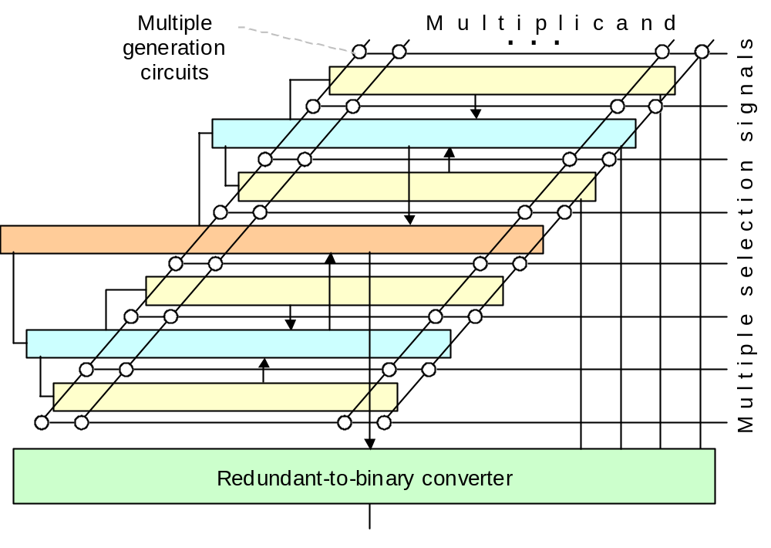
Example Multiplier with 4-to-2 Reduction Tree
Even if 4-to-2 reduction is implemented using two CSA levels, design regularity potentially makes up for the larger number of logic levels
Similarly, using Booth’s recoding may not yield any advantage, because it introduces irregularity
Fig. 11.6 Layout of a partial-products reduction tree composed of 4-to-2 reduction modules. Each solid arrow represents two numbers.
Apr. 2020
Computer Arithmetic, Multiplication
Slide <number>

Slide 61
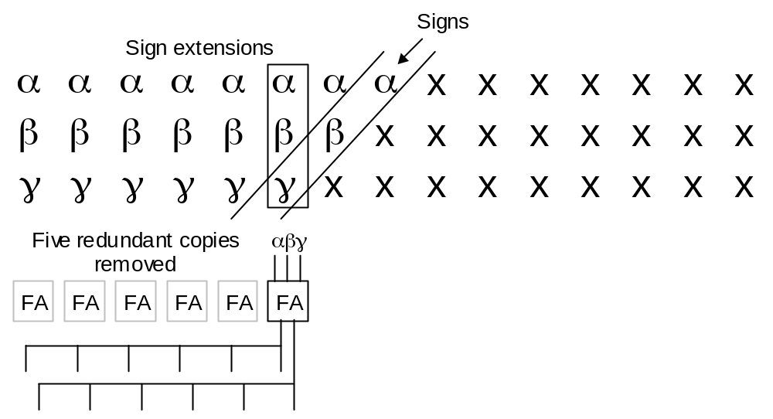
11.3 Tree Multipliers for Signed Numbers
---------- Extended positions ---------- Sign Magnitude positions ---------
x_{k–1} x_{k–1} x_{k–1} x_{k–1} x_{k–1} x_{k–1} x_{k–2} x_{k–3} x_{k–4} . . .
y_{k–1} y_{k–1} y_{k–1} y_{k–1} y_{k–1} y_{k–1} y_{k–2} y_{k–3} y_{k–4} . . .
z_{k–1} z_{k–1} z_{k–1} z_{k–1} z_{k–1} z_{k–1} z_{k–2} z_{k–3} z_{k–4} . . .
From Fig. 8.19a Sign extension in multioperand addition.
The difference in multiplication is the shifting sign positions
Fig. 11.7 Sharing of full adders to reduce the CSA width in a signed tree multiplier.
Apr. 2020
Computer Arithmetic, Multiplication
Slide <number>

Slide 62
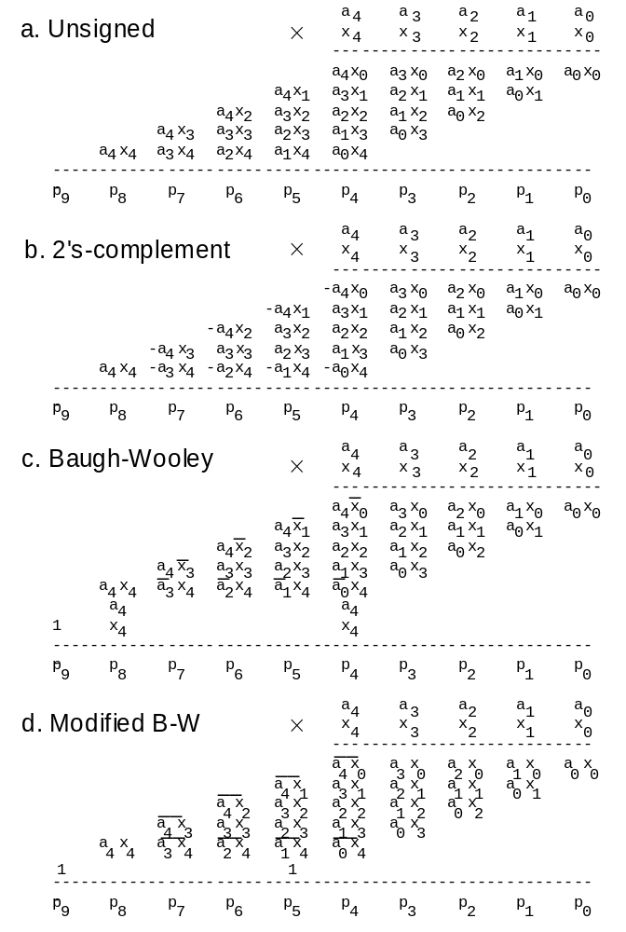
Using the Negative-Weight Property of the Sign Bit
Sign extension is a way of converting negatively weighted bits (negabits) to positively weighted bits (posibits) to facilitate reduction, but there are other methods of accomplishing the same without introducing a lot of extra bits
Baugh and Wooley have contributed two such methods
Fig. 11.8 Baugh-Wooley
2’s-complement multiplication.
Apr. 2020
Computer Arithmetic, Multiplication
Slide <number>

Slide 63
The Baugh-Wooley Method and Its Modified Form
Fig. 11.8
–a₄x₀ = a₄(1 – x₀) – a₄
= a₄x₀′ – a₄
–a₄ a₄x₀′
a₄
In next column
–a₄x₀ = (1 – a₄x₀) – 1
= (a₄x₀)′ – 1
–1 (a₄x₀)′
1
In next column
Apr. 2020
Computer Arithmetic, Multiplication
Slide <number>

Slide 64
Alternate Views of the Baugh-Wooley Methods
+ 0 0 –a₄x₃ –a₄x₂ –a₄x₁ –a₄x₀
+ 0 0 –a₃x₄ –a₂x₄ –a₁x₄ –a₀x₄
--------------------------------------------
– 0 0 a₄x₃ a₄x₂ a₄x₁ a₄x₀
– 0 0 a₃x₄ a₂x₄ a₁x₄ a₀x₄
--------------------------------------------
+ 1 1 a₄x₃ a₄x₂ a₄x₁ a₄x₀
+ 1 1 a₃x₄ a₂x₄ a₁x₄ a₀x₄
1
1
--------------------------------------------
+ a₄ a₄ a₄x₃ a₄x₂ a₄x₁ a₄x₀
+ x₄ x₄ a₃x₄ a₂x₄ a₁x₄ a₀x₄
a₄
x₄
--------------------------------------------
a₄
1 x₄
Apr. 2020
Computer Arithmetic, Multiplication
Slide <number>

Slide 65
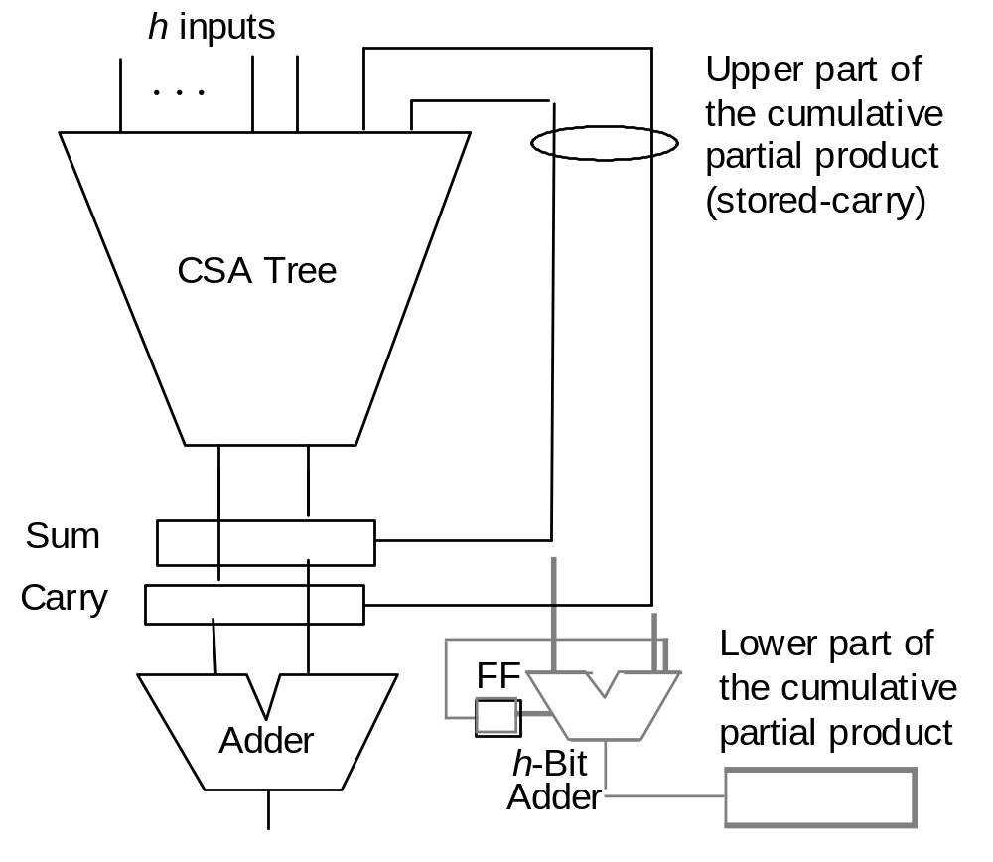
11.4 Partial-Tree and Truncated Multipliers
High-radix versus partial-tree multipliers: The difference is quantitative, not qualitative
For small h, say ≤ 8 bits,
we view the multiplier of
Fig. 11.9 as high-radix
When h is a significant fraction of k, say k/2 or k/4,
then we tend to view it as
a partial-tree multiplier
Better design through pipelining
to be covered in Section 11.6
Fig. 11.9 General structure of a partial-tree multiplier.
Apr. 2020
Computer Arithmetic, Multiplication
Slide <number>

Slide 66
Why Truncated Multipliers?
Nearly half of the hardware in array/tree multipliers is there to get the last bit right (1 dot = one FPGA cell)
ulp
.         k-by-k fractional
× .         multiplication
---------------------------------
.       |
.      | 
.     |  
.    |   
.   |    
.  |     
. |      
. |       
---------------------------------
.        |       
Max error = 8/2 + 7/4
+ 6/8 + 5/16 + 4/32
+ 3/64 + 2/128
+ 1/256 = 7.004 ulp
Mean error =
1.751 ulp
Fig. 11.10 The idea of a truncated multiplier with 8-bit fractional operands.
Apr. 2020
Computer Arithmetic, Multiplication
Slide <number>

Slide 67
Truncated Multipliers with Error Compensation
We can introduce additional “dots” on the left-hand side to compensate for the removal of dots from the right-hand side
Constant compensation Variable compensation
. o o o o o o o| . o o o o o o o|
. o o o o o o| . o o o o o o|
. o o o o o| . o o o o o|
. o o o o| . o o o o|
. o o o| . o o o|
. 1 o o| . o o|
. o| . x₋₁o|
. | . y₋₁ |
Constant and variable error compensation for truncated multipliers.
Max error = +4 ulp
Max error ≅ −3 ulp
Max error = +? ulp
Max error ≅ −? ulp
Mean error = ? ulp
Mean error = ? ulp
Apr. 2020
Computer Arithmetic, Multiplication
Slide <number>

Slide 68
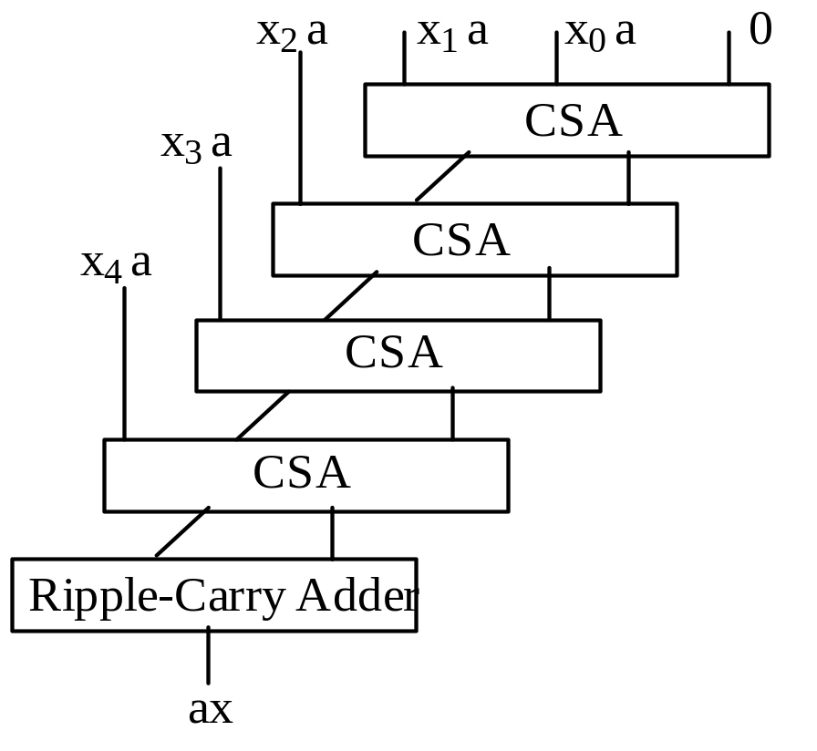
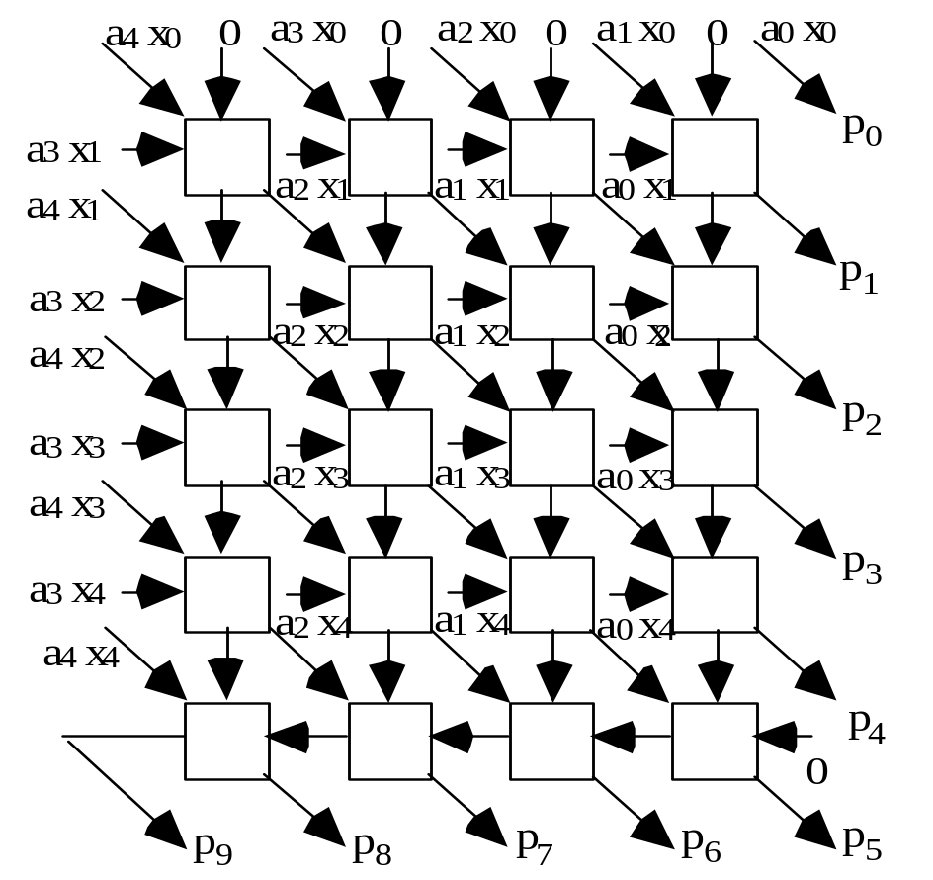
11.5 Array Multipliers
Fig. 11.11 A basic array multiplier uses a one-sided CSA tree and a ripple-carry adder.
Fig. 11.12 Details of a 5 × 5 array multiplier using FA blocks.
Apr. 2020
Computer Arithmetic, Multiplication
Slide <number>

Slide 69
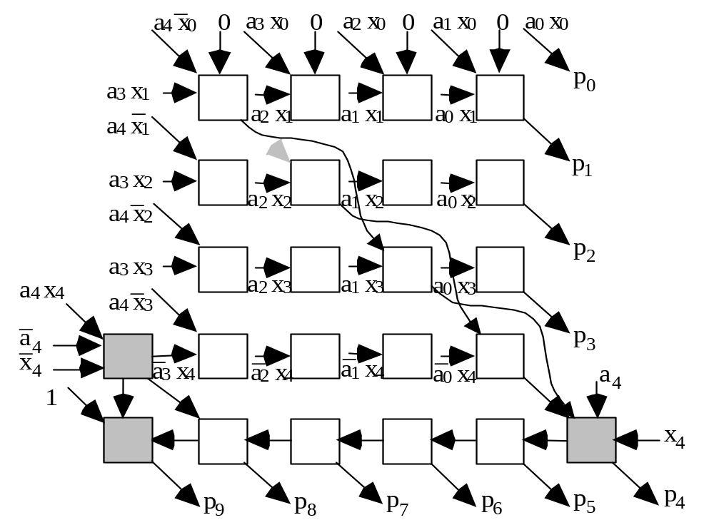
Signed (2’s-complement) Array Multiplier
Fig. 11.13 Modifications in a 5 × 5 array multiplier to deal with 2’s-complement inputs using the Baugh-Wooley method or to shorten the critical path.
Apr. 2020
Computer Arithmetic, Multiplication
Slide <number>

Slide 70
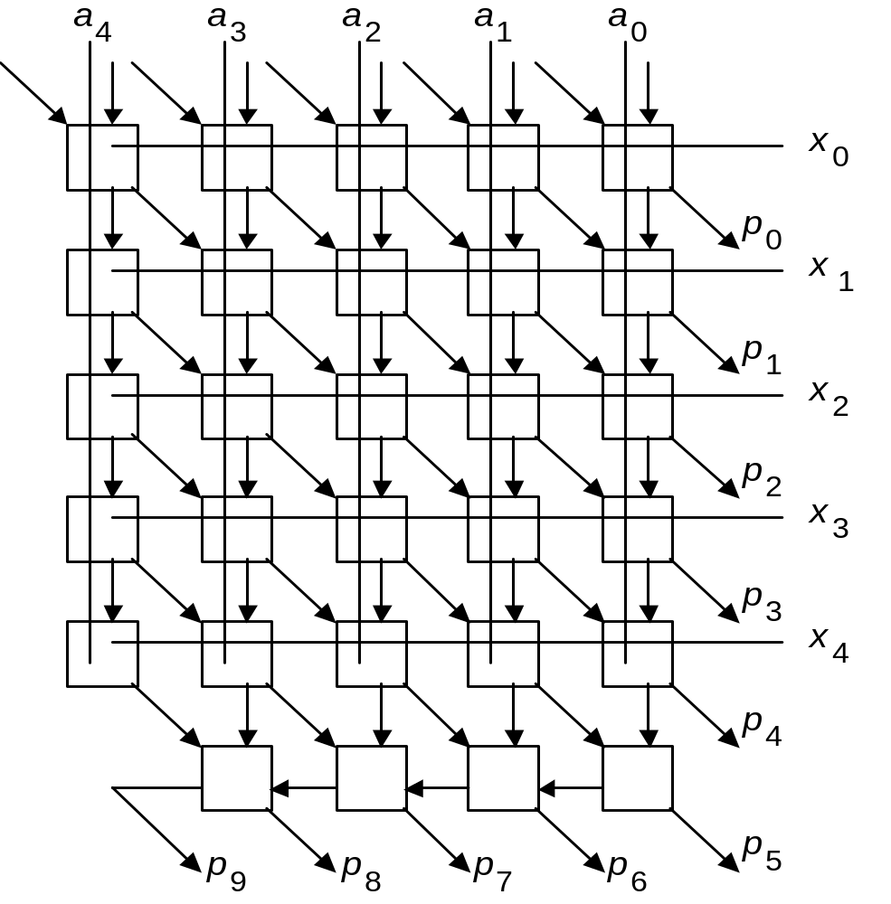
Array Multiplier Built of Modified Full-Adder Cells
Fig. 11.14 Design of a 5 × 5 array multiplier with two additive inputs and full-adder blocks that include AND gates.
FA
Apr. 2020
Computer Arithmetic, Multiplication
Slide <number>

Slide 71
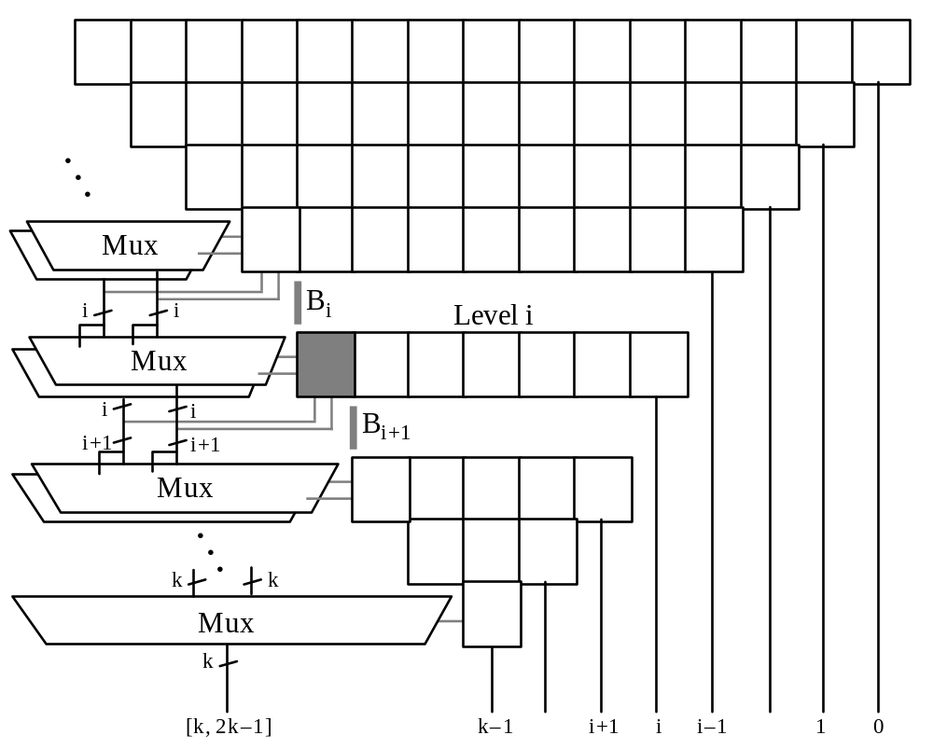
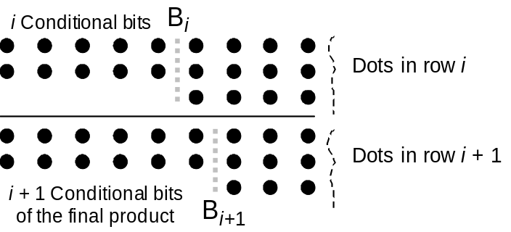
Array Multiplier without a Final Carry-Propagate Adder
Fig. 11.15 Conceptual view of a modified array multiplier that does not need a final carry-propagate adder.
Fig. 11.16 Carry-save addition, performed in level i, extends the conditionally computed bits of the final product.
All remaining bits of the final product produced only 2 gate levels after p_{k–1}
Apr. 2020
Computer Arithmetic, Multiplication
Slide <number>

Slide 72
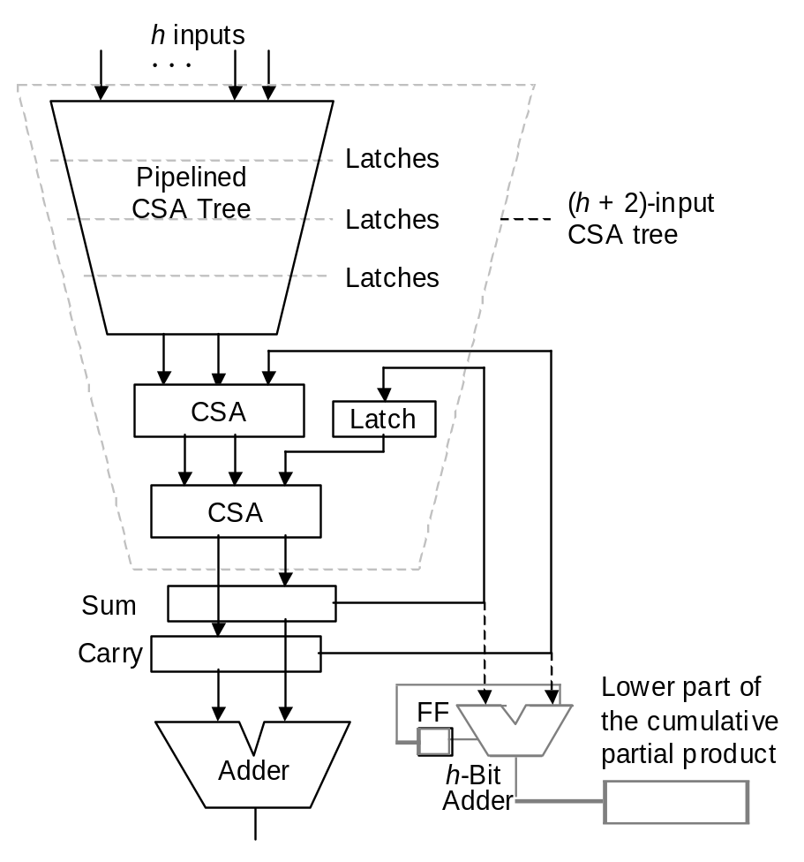
11.6 Pipelined Tree and Array Multipliers
Fig. 11.9 General structure of a partial-tree multiplier.
Fig. 11.17 Efficiently pipelined partial-tree multiplier.
Apr. 2020
Computer Arithmetic, Multiplication
Slide <number>

Slide 73
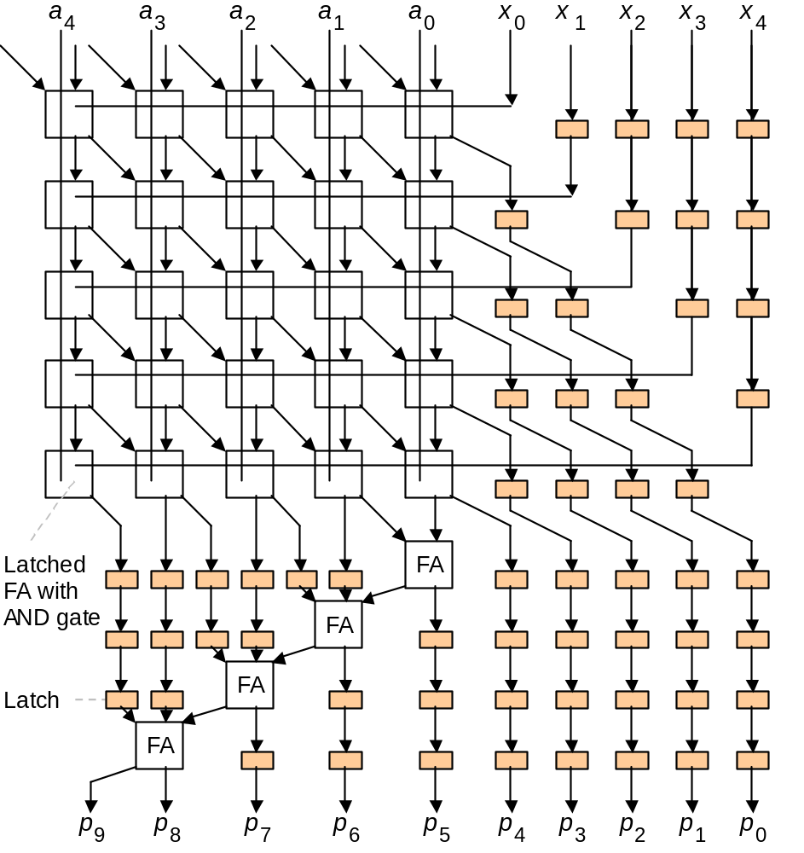
Pipelined Array Multipliers
With latches after every FA level, the maximum throughput is achieved
Latches may be inserted after every h FA levels for an intermediate design
Example: 3-stage pipeline
Fig. 11.18 Pipelined 5 × 5 array multiplier using latched FA blocks.
The small shaded boxes are latches.
Apr. 2020
Computer Arithmetic, Multiplication
Slide <number>

Slide 74
12 Variations in Multipliers
Chapter Goals
Learn additional methods for synthesizing
fast multipliers as well as other types
of multipliers (bit-serial, modular, etc.)
Chapter Highlights
Building a multiplier from smaller units
Performing multiply-add as one operation
Bit-serial and (semi)systolic multipliers
Using a multiplier for squaring is wasteful
Apr. 2020
Computer Arithmetic, Multiplication
Slide <number>

Slide 75
Variations in Multipliers: Topics
Topics in This Chapter
12.1 Divide-and-Conquer Designs
12.2 Additive Multiply Modules
12.3 Bit-Serial Multipliers
12.4 Modular Multipliers
12.5 The Special Case of Squaring
12.6 Combined Multiply-Add Units
Apr. 2020
Computer Arithmetic, Multiplication
Slide <number>

Slide 76
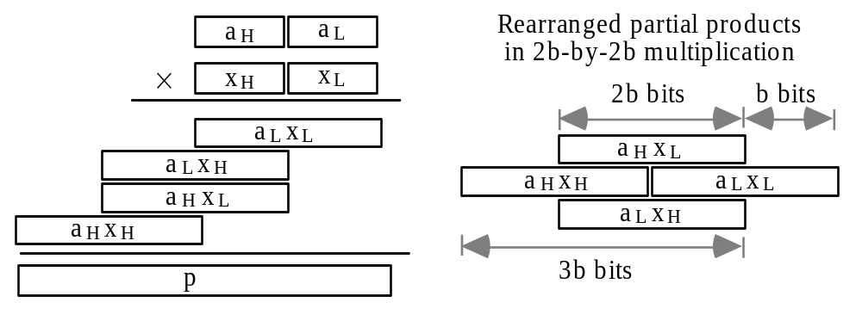
12.1 Divide-and-Conquer Designs
Building wide multiplier from narrower ones
Fig. 12.1 Divide-and-conquer (recursive) strategy for synthesizing a 2b × 2b multiplier from b × b multipliers.
Apr. 2020
Computer Arithmetic, Multiplication
Slide <number>

Slide 77
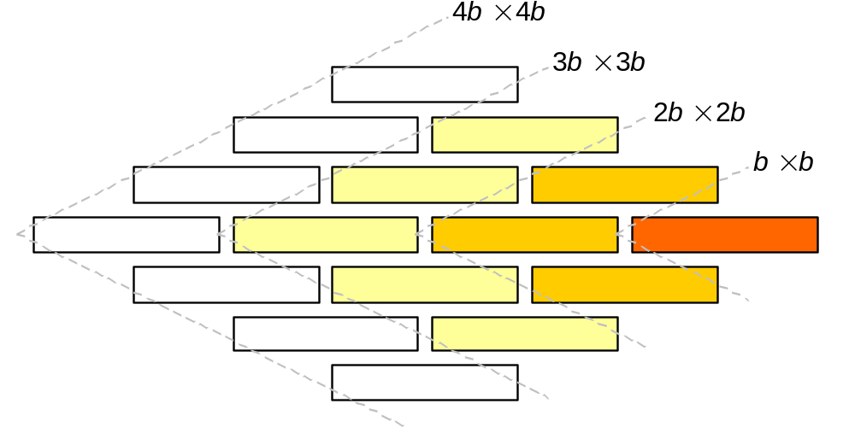
General Structure of a Recursive Multiplier
2b × 2b use (3; 2)-counters
3b × 3b use (5; 2)-counters
4b × 4b use (7; 2)-counters
Fig. 12.2 Using b × b multipliers to synthesize 2b × 2b, 3b × 3b, and 4b × 4b multipliers.
Apr. 2020
Computer Arithmetic, Multiplication
Slide <number>

Slide 78
Using b × c, rather than b × b Building Blocks
2b × 2c use b × c multipliers and (3; 2)-counters
2b × 4c use b × c multipliers and (5?; 2)-counters
gb × hc use b × c multipliers and (?; 2)-counters
Apr. 2020
Computer Arithmetic, Multiplication
Slide <number>

Slide 79
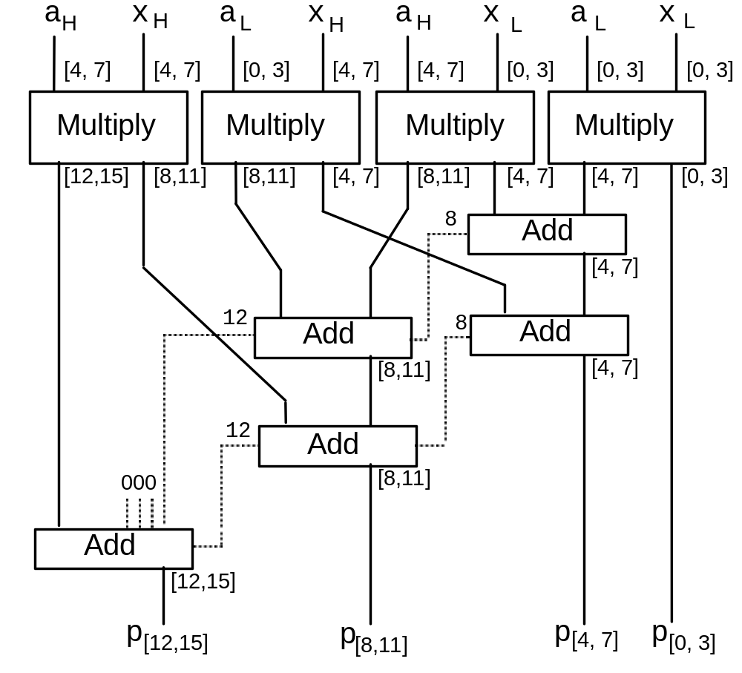
Wide Multiplier Built of Narrow Multipliers and Adders
Fig. 12.3 Using 4 × 4 multipliers and 4-bit adders to synthesize an 8 × 8 multiplier.
Apr. 2020
Computer Arithmetic, Multiplication
Slide <number>

Slide 80
Karatsuba Multiplication
2b × 2b multiplication requires four b × b multiplications:
(2^{b}a_{H} + a_{L}) × (2^{b}x_{H} + x_{L}) = 2^{2b}a_{H}x_{H} + 2^{b} (a_{H}x_{L} + a_{L}x_{H}) + a_{L}x_{L}
Karatsuba noted that one of the four multiplications can be removed at the expense of introducing a few additions:
(2^{b}a_{H} + a_{L}) × (2^{b}x_{H} + x_{L}) =
2^{2b}a_{H}x_{H} + 2^{b} [(a_{H} + a_{L}) × (x_{H} + x_{L}) – a_{H}x_{H} – a_{L}x_{L}] + a_{L}x_{L}
b bits
a_{H}
a_{L}
x_{H}
x_{L}
Mult 1
Mult 3
Mult 2
Benefit is quite significant for extremely wide operands
(4/3)⁵ = 4.2 (4/3)¹⁰ = 17.8 (4/3)²⁰ = 315.3 (4/3)⁵⁰ = 1,765,781
Apr. 2020
Computer Arithmetic, Multiplication
Slide <number>

Slide 81
Computational Complexity of Multiplication
Arnold Schonhage and Volker Strassen (via FFT); best until 2007
O(log k) time
O(k log k log log k) complexity
In 2007, Martin Furer managed to replace the log log k term with an asymptotically smaller term (for astronomically large numbers)
It is an open problem whether there exist logarithmic-delay multipliers with linear cost
(it is widely believed that there are not)
In the absence of a linear cost multiplication circuit, multiplication must be viewed as a more difficult problem than addition
In 2019, David Harvey and Joris van der Hoeven developed an O(k log k) multiplication algorithm, which is believed to be the best possible theoretically (but not practical at present)
Apr. 2020
Computer Arithmetic, Multiplication
Slide <number>

Slide 82
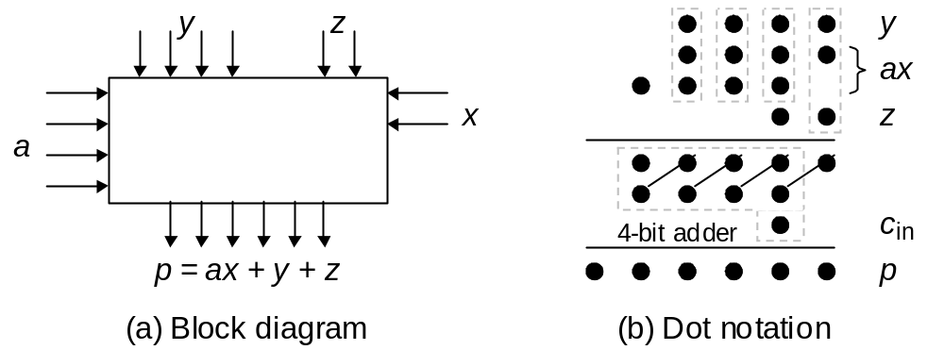
12.2 Additive Multiply Modules
Fig. 12.4 Additive multiply module with 2 × 4 multiplier (ax) plus 4-bit and 2-bit additive inputs (y and z).
b-bit and c-bit multiplicative inputs
b × c AMM b-bit and c-bit additive inputs
(b + c)-bit output
(2^{b} – 1) × (2^{c} – 1) + (2^{b} – 1) + (2^{c} – 1) = 2^{b+c} – 1
Apr. 2020
Computer Arithmetic, Multiplication
Slide <number>

Slide 83
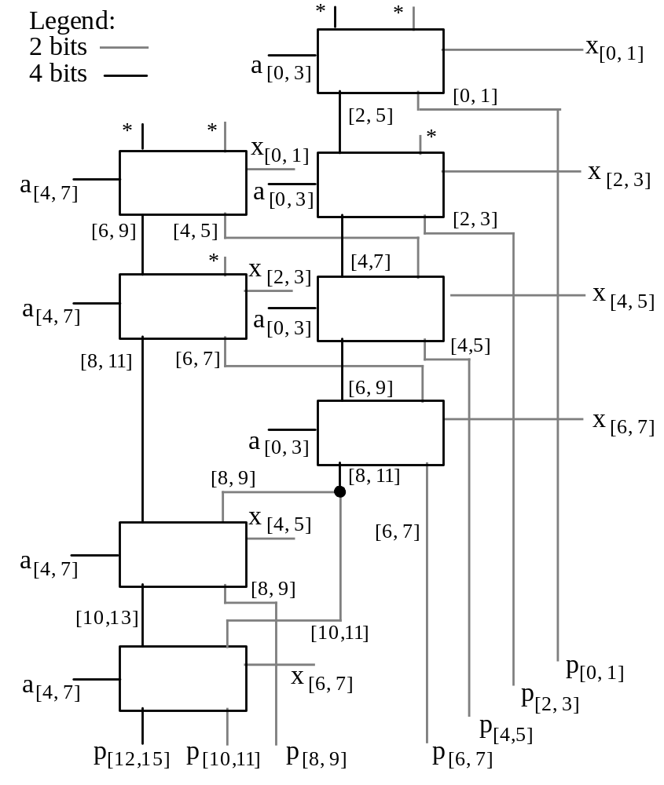
Multiplier Built of AMMs
Understanding an 8 × 8 multiplier built of 4 × 2 AMMs using dot notation
Fig. 12.5 An 8 × 8 multiplier built of 4 × 2 AMMs. Inputs marked with an asterisk carry 0s.
Apr. 2020
Computer Arithmetic, Multiplication
Slide <number>

Slide 84
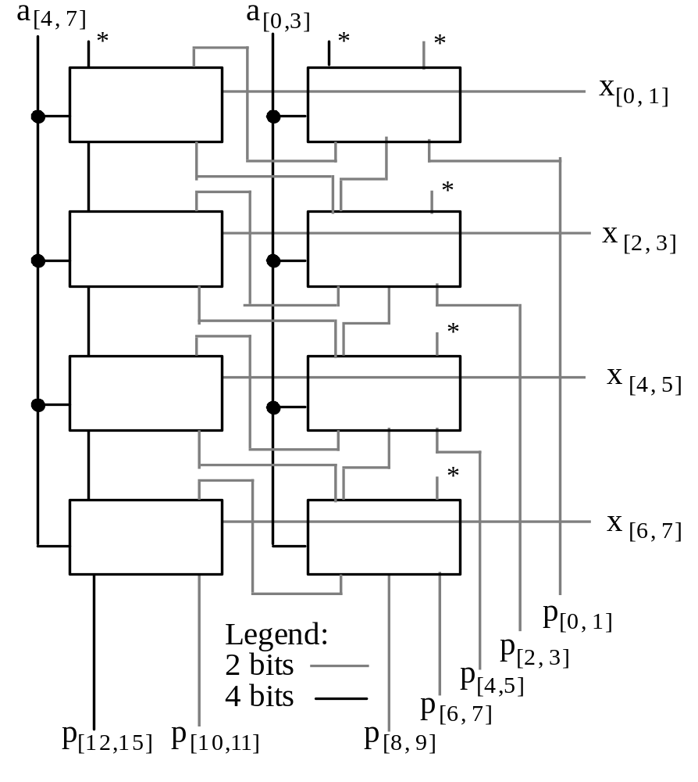
Multiplier Built of AMMs: Alternate Design
This design is more regular than that in Fig. 12.5 and is easily expandable to larger configurations; its latency, however, is greater
Fig. 12.6 Alternate 8 × 8 multiplier design based on 4 × 2 AMMs. Inputs marked with an asterisk carry 0s.
Apr. 2020
Computer Arithmetic, Multiplication
Slide <number>

Slide 85
12.3 Bit-Serial Multipliers
Bit-serial adder
(LSB first)
…
x₂
x₁
x₀
FF
…
s₂
s₁
s₀
FA
…
y₂
y₁
y₀
Bit-serial multiplier
…
a₂
a₁
a₀
?
…
(Must follow the k-bit inputs with k 0s; alternatively, view the product as being only k bits wide)
p₂
p₁
p₀
…
x₂
x₁
x₀
What goes inside the box to make a bit-serial multiplier?
Can the circuit be designed to support a high clock rate?
Apr. 2020
Computer Arithmetic, Multiplication
Slide <number>

Slide 86
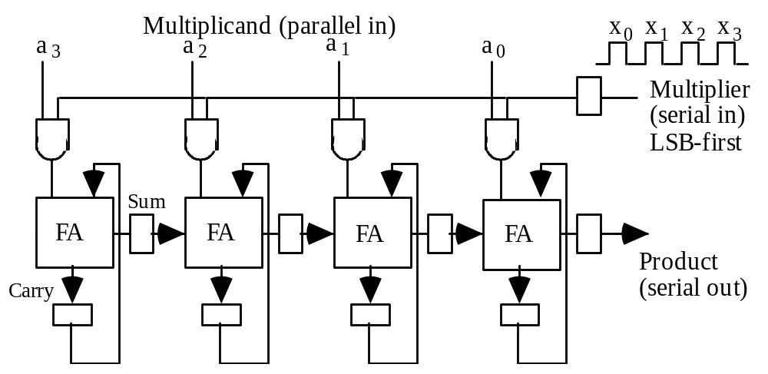
Semisystolic Serial-Parallel Multiplier
Fig. 12.7 Semi-systolic circuit for 4 × 4 multiplication in 8 clock cycles.
This is called “semisystolic” because it has a large signal fan-out of k (k-way broadcasting) and a long wire spanning all k positions
Apr. 2020
Computer Arithmetic, Multiplication
Slide <number>

Slide 87
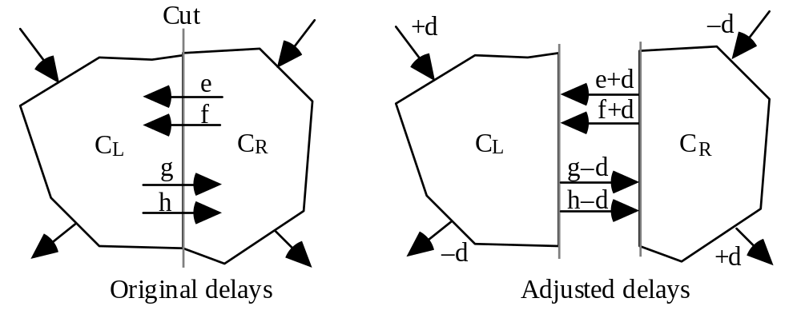
Systolic Retiming as a Design Tool
A semisystolic circuit can be converted to a systolic circuit via retiming, which involves advancing and retarding signals by means of delay removal and delay insertion in such a way that the relative timings of various parts are unaffected
Fig. 12.8 Example of retiming by delaying the inputs to C_{L} and advancing the outputs from C_{L} by d units
Apr. 2020
Computer Arithmetic, Multiplication
Slide <number>

Slide 88
Alternate Explanation of Systolic Retiming
t
t
t+d₁
d₁
t
t + a
d₁
d₂
t+a+d₁+d₂
t+a+d₁
d₂
t+a+d₁+d₂
Transferring delay from the outputs of a subsystem to its inputs does not change the behavior of the overall system
Apr. 2020
Computer Arithmetic, Multiplication
Slide <number>

Slide 89
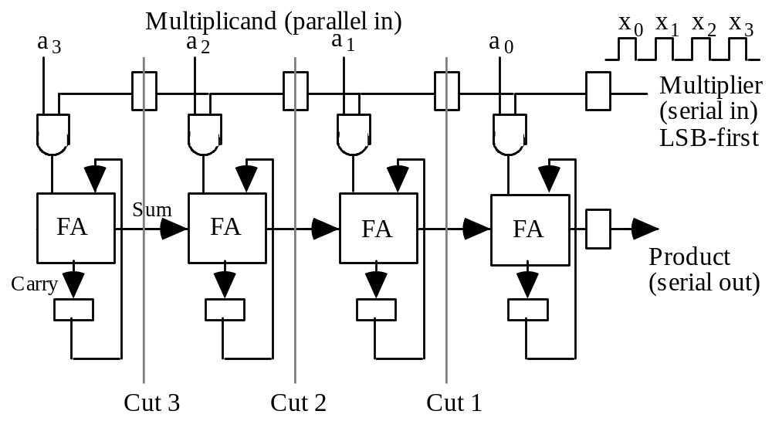
A First Attempt at Retiming
Fig. 12.7
Fig. 12.9 A retimed version of our semi-systolic multiplier.
Apr. 2020
Computer Arithmetic, Multiplication
Slide <number>

Slide 90

Deriving a Fully Systolic Multiplier
Fig. 12.7
Fig. 12.10 Systolic circuit for
4 × 4 multiplication in 15 cycles.
Apr. 2020
Computer Arithmetic, Multiplication
Slide <number>

Slide 91



A Direct Design for a Bit-Serial Multiplier
Fig. 12.11 Building block for a latency-free bit-serial multiplier.
Fig. 12.12 The cellular structure of the bit-serial multiplier based on the cell in Fig. 12.11.
Fig. 12.13 Bit-serial multiplier design in dot notation.
Apr. 2020
Computer Arithmetic, Multiplication
Slide <number>

Slide 92


12.4 Modular Multipliers
Fig. 12.14 Modulo-(2^{b} – 1) carry-save adder.
Fig. 12.15 Design of a
4 × 4 modulo-15 multiplier.
Apr. 2020
Computer Arithmetic, Multiplication
Slide <number>

Slide 93


Other Examples of Modular Multiplication
Fig. 12.16 One way to design of a 4 × 4 modulo-13 multiplier.
Fig. 12.17 A method for modular multioperand addition.
Apr. 2020
Computer Arithmetic, Multiplication
Slide <number>

Slide 94

12.5 The Special Case of Squaring
x₁x₀
–x₁x₀
Fig. 12.18 Design of a 5-bit squarer.
Apr. 2020
Computer Arithmetic, Multiplication
Slide <number>

Slide 95
Divide-and-Conquer Squarers
Building wide squarers from narrower ones
x_{H}
x_{L}
x_{L}
x_{H}
x_{L}
x_{H}
x_{L}
x_{H}
x_{L}
x_{H}
Divide-and-conquer (recursive) strategy for synthesizing a 2b × 2b squarer from b × b squarers and multiplier.
Apr. 2020
Computer Arithmetic, Multiplication
Slide <number>

Slide 96
12.6 Combined Multiply-Add Units
Additive input
Multiply-add
versus
multiply-accumulate
Multiply-accumulate units often have wider additive inputs
(a)
CSA tree output
Carry-save additive input
(b)
CSA tree output
Additive input
Fig. 12.19
Dot-notation representations
of various methods
for performing
a multiply-add operation
in hardware.
Dot matrix for the
4 × 4 multiplication
(c)
Carry-save additive input
Dot matrix for the
4 × 4 multiplication
(d)
Apr. 2020
Computer Arithmetic, Multiplication
Slide <number>

